Slide 1
PRIIPs KID: what’s going wrong?
June 2020

Slide 2



PRIIPs: what are we talking about?
Insurance-based retail investment products
Packaged retail investment products**
Unit-linked
Derivatives
With-profit
Structured products
Hybrids
Alternative Investment Funds
Annuities
Other funds
>77%
Guaranteed products
*
Index-linked
Funeral
Other
* Around €5trn of assets under management in 2018, based on Insurance Europe estimates
** UCITS are exempt until 2022
Notes:
The Packaged Retail and Insurance-based Investment Products (PRIIPs) key information document (KID) is intended to apply the same very prescriptive disclosure standards to a wide variety of very different products.
However, in practice, it applies mainly to insurance products for the time being, as UCITS funds are still excluded from the scope of the PRIIPs Regulation.
Based on Insurance Europe estimates, IBIPs represent around 77% of the current overall PRIIPs market, with around 5 trillion EUR of assets under management in 2018.
Figures on AuM for structured products and funds sold to retail investors are taken from the 2019 ESMA report on costs and performance. Figures on the IBIPs market are based on national statistic provided by our members.
This demonstrates that insurers are a key stakeholder in the PRIIPs discussions and need disclosures that are fit for insurance products and meaningful to insurance consumers.

Slide 3



PRIIPs KID: disclosures misleading consumers
Original objectives
Reality check
Comparability
Intelligibility
Better informed decisions
Confusing
Misleading
Increased
compliance risk
Why? The PRIIPs KID was designed with investment products in mind, but in practice it applies mainly to insurance products.
And now? The European Commission and the EU supervisory authorities are trying to fix the PRIIPs KID issues and facilitate the inclusion of UCITS, but flawed regulatory changes via a mini-review will make the PRIIPs KID even worse.
3
Notes:
The high level of prescriptiveness means the KID fails to capture the key features of insurance products and misrepresents certain information that is important to retail investors. Despite the very laudable intentions, the PRIIPs KID is difficult to understand and — at times — even misleading.
To address the complexity and initial shortcomings of the KID, the PRIIPs framework has needed a series of adjustments and clarifications. The EU Commission and the EU Supervisory Authorities are now trying to fix the PRIIPs KID issues one more time, but hurried regulatory changes will make the PRIIPs KID even worse.

Slide 4
Flawed process and timeline
….lead to fragmented regulatory changes and increase confusion for both consumers and insurers
Quick fix Level 1 PRIIPs Regulation Dec 2016
Rejection Level 2 RTS by EP Sep 2016
ESAs supervisory statement Feb 2019
Level 1 PRIIPs Regulation Dec 2014
ESAs supervisory statement Oct 2019
Official Level 1 review
EC Communication Jul 2017
End of UCITS exemption 2022
Likely changes to Level 3
Likely new/review Level 3
Likely changes to Level 2
Likely changes to Level 3
Level 2 RTS Apr 2017
Mini review 2020
Q&As Nov 2017
Q&As Aug 2017
Q&As Apr 2019
Q&As Jul 2017
Q&As Jul 2018
Level 1
Level 2
Level 3
4
Notes:
To address the flaws in the KID, the adoption of the PRIIPs Regulation and its delegated regulations was followed by EC guidelines, several successive batches of Q&As by the ESAs and two supervisory statements.
Now the delegated regulations are subject to a mini-review ahead of a formal PRIIPs review that could result in further changes to both the PRIIPs Regulation and delegated regulations, therefore most likely necessitating new Level 3 measures.
We have serious concerns with the “quick-fix” that has been undertaken. It is vital that any new measures address the underlying problems with the PRIIPs KID and do not attempt to find superficial and ineffective solutions.
These successive changes to the PRIIPs KID not only result in unnecessary high compliance costs for the industry, but they also confuse consumers further and reduce their trust in the information they receive and ultimately in the insurance industry.
Level 1 Regulation: published in EUOJ on 9.12.2014
Level 2: published in EUOJ on 12.4.2017
EC Communication: 7.7.2017
Q&As: 4.7.2017,
Q&A 18.8.2017,
Q&A 20.11.2017,
Level 1 applicable from 1.1.2018
Q&A 19.7.2018
Supervisory Statement: 8.2.2019
Q&A 4.4.2019
Supervisory Statement: 24.10.2019
Mini-review: ongoing, changes to Level 2 to be adopted and implemented in 2020/2021
Additional Level 2 review for UCITS: implemented from January 2022
Official review: Level 1, with possible changes to level 2 and 3

Slide 5





Where we are now: PRIIPs mini review
ESAs working on brand new proposals, including on performance and cost disclosures:
  New backward looking scenarios for linear funds and unit-linked
  Current future performance methodology for the other PRIIPs, with manufacturer discretion in making adjustments
  Link to past performance according to UCITS methodology for the majority of funds
  Different cost indicators for insurance and MiFID products (Reduction in Yield to continue to be used for IBIPs)
  Introduction of additional costs information for multi-option products (MOPs)
These proposals are:
Last minute and constantly changing
Not sufficiently tested
Confusing for consumers
Costly to implement
Designed for funds, not insurance
5
Notes:
The technical changes that are now being considered by the ESAs are rushed and not sufficiently tested to ensure they truly improve the KID and are useful to consumers’ understanding of the product. In fact, they would make the KID more complex and more confusing to consumers.
Based on the secretariat’s current understanding, the ESAs are considering:
New backward looking scenarios for linear funds and unit-linked
Current future performance methodology for the other PRIIPs, with manufacturer discretion in making adjustments
Link to past performance according to UCITS methodology for the majority of funds
Different cost indicators for insurance and MiFID products (Reduction in Yield to continue to be used for IBIPs)
Introduction of additional costs information for multi-option products (MOPs)
The ESAs have been forced to find and push for compromise technical proposals that would not be rejected by the Commission and Parliament. In our view the process is now driven by a need to ‘get something agreed’ rather than focused on the real needs of consumers. The disagreements between the institutions demonstrate that it is not possible to resolve issues with the PRIIPs KID within the existing level 1 framework

Slide 6
Repeated changes of direction
Proposals on cost
Proposals on performance scenarios
ESAs dropped TCR proposal and produced 4 alternative options for costs disclosures
ESAs considering to use the same cost indicator for all products
ESAs consulted on dividend yield methodology for performance
ESAs dropped dividend yield methodology
ESAs dropped option to use the same cost indicator for all products
ESAs finalise proposals on backward looking scenarios for certain PRIIPs, with a different methodology for all other PRIIPs and for stress scenarios
ESAs finalise proposals on different cost indicators for insurance and MiFID products
Insurance Europe provided evidence on flaws with dividend yield methodology
Insurance Europe feedback critical of number of disclosures
ESAs work on Total Cost Ratio (TCR)
Insurance Europe provided evidence on flaws in TCR
2019
2020
MAY | JUN | JUL | AUG | SEP | OCT | NOV | DEC | JAN | FEB | MAR | APR | MAY | JUN
Planned adoption of RTS changes
Possible adoption of RTS changes
No sufficient testing showing that the proposals are workable and beneficial
Notes:
We have already seen significant changes of direction in ESAs’ approach over the last months.
The current round of changes follows a public consultation held earlier this year where feedback from all stakeholders was very negative, meaning the majority of proposals had to be discarded.
The public consultations and the moments of dialogue with the industry have been particularly useful to assess the limits and unintended negative consequences of some proposals such as the Total Cost Ratio (TCR), the dividend yield methodology or the backward looking scenarios.
However, the news proposals will not be subject to public consultation nor consumer testing and might be adopted in a rush.

Slide 7

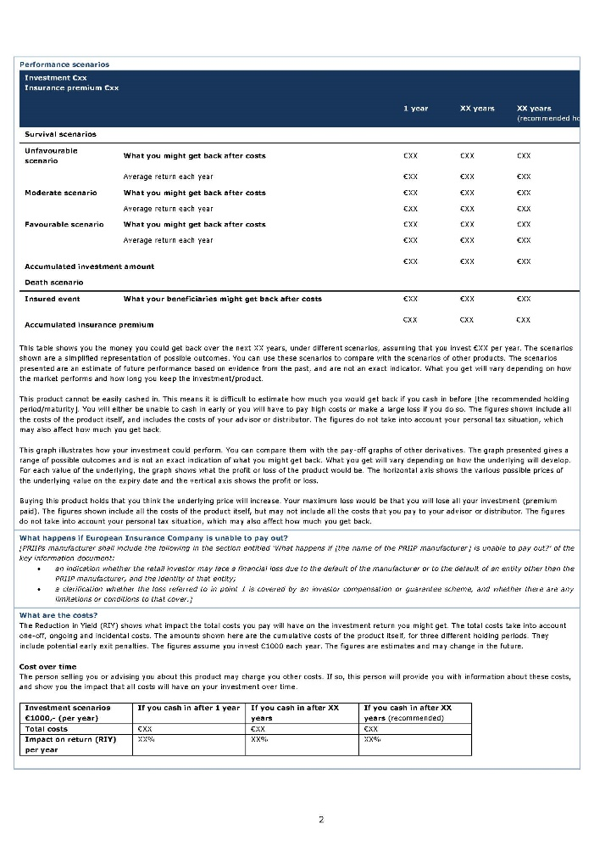

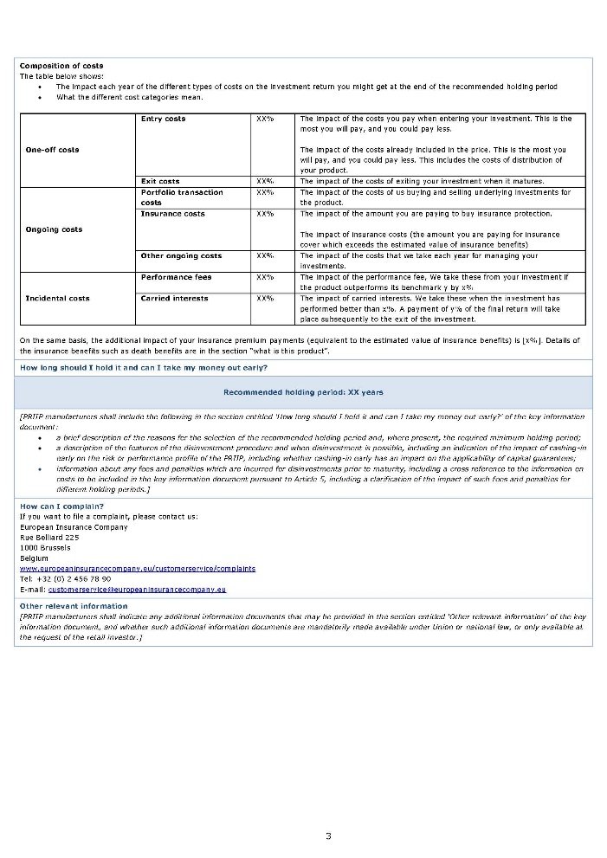
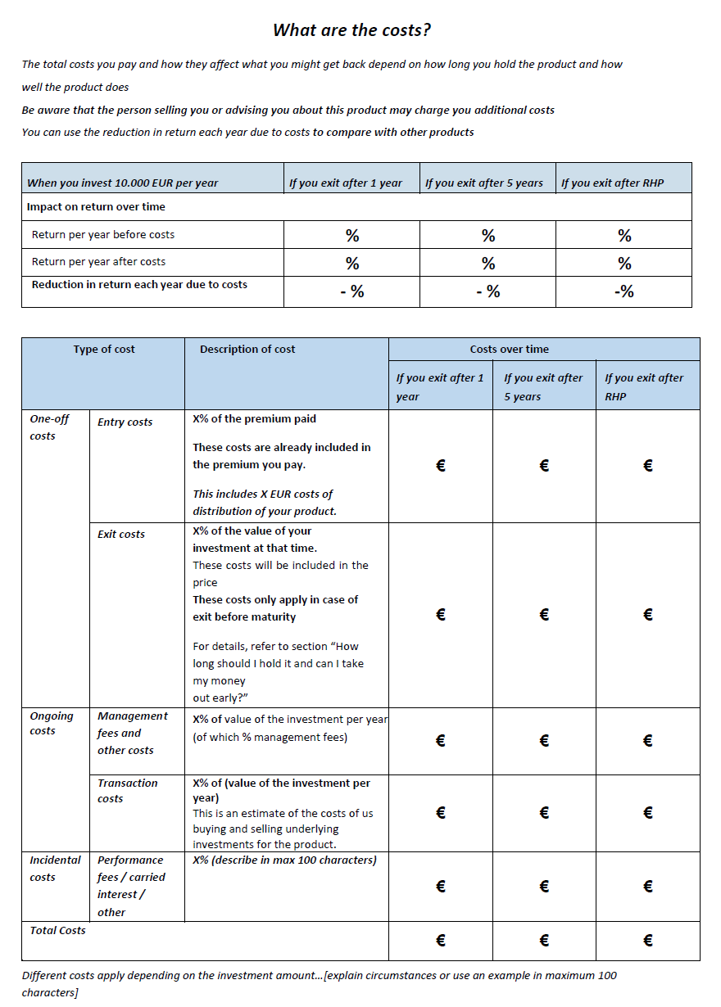
Interim solutions confuse consumers further
New backward looking scenarios for certain PRIIPs, with a different methodology for all other PRIIPs and for stress scenarios?
Incomparable cost indicators for insurance products and funds?
Inconsistent figures between table 1 on total costs and table 2 on split of costs?
Link to past performance based on UCITS KIID methodology
only for certain PRIIPs?
7
Notes:
Based on the secretariat’s current understanding, the ESAs are considering:
New backward looking scenarios for linear funds and unit-linked
Current future performance methodology for the other PRIIPs, with manufacturer discretion in making adjustments
Link to past performance according to UCITS methodology for the majority of funds
Different cost indicators for insurance and MiFID products (Reduction in Yield to continue to be used for IBIPs)
Introduction of additional costs information for multi-option products (MOPs)
This will not result in meaningful improvements to the contents of the PRIIPs KID. In contrast, these interim changes will confuse consumers and devalue the information provided in the PRIIPs KID.

Slide 8


Consumer testing is too limited
The latest ESAs proposals have not been sufficiently tested
  No ad hoc consumer testing
  No solid testing showing that proposals are workable
Previous Commission’s consumer testing:
  Limited to the presentation of performance scenarios (no testing of performance scenarios methodology, cost disclosures, etc.)
  Covered 4 options tested in only 5 countries
  Found no clear improvements compared to the current KID
  Mixed findings on consumer understanding
Example: “The presentation of past and future information together does not seem to raise issues… However, when we asked more specifically about the relevance of the past performance for future outcomes, responses were more varied and a significant proportion of participants indicated that they made a connection between past performance and the potential future performance”
Notes:
On 27 February, the European Commission published its final report on consumer testing of different options for the presentation of performance information in the PRIIPs. The consumer testing included four options for the presentation of performance tested on a sample of 7,684 consumers and covering four different IBIPs. However, the sample was only drawn from five countries (PL, DE, SE, FR, IT), while the EC consumer testing of 2015 was run in ten plus six markets.
The consumer testing shows that the revised versions of the presentation of performance do not perform significantly better than the current KID and led to mixed outcomes.
The consumer testing report includes a number of inconsistent and contradictory statements [see COB-PRI-20-010 ].
What’s worse, the latest ESAs proposals have not been subject to specific consumer testing nor public consultation. The limited simulations and impact assessment that ESAs might have performed do not provide a solid basis to justify the changes.

Slide 9
Interim solutions confuse consumers further
Proposals on performance scenarios
New ‘backward looking scenarios’ for some PRIIPs imply past performance indicates future performance
Different methodology for all other PRIIPs and for the stress scenarios
Referring to both future and past performance increases confusion
Insufficient testing
9
Notes:
New ‘backward looking scenarios’ for some PRIIPs imply past performance indicates future performance
Different methodology for all other PRIIPs and for the stress scenarios
Referring to both future and past performance increases confusion
Insufficient testing

Slide 10
Interim solutions confuse consumers further
Proposals on costs
Figures are no longer comparable between insurance and MiFID products
RIY is a robust cost indicator applicable to all products
Increased number of figures
10
10
Notes:
Based on the secretariat’s current understanding, the ESAs are considering using different cost indicators for MiFID and insurance products.
Reduction in Yield is expected to be retained for insurance products. Insurance Europe believes this is a robust cost indicator.
However, the use of a different cost indicator for MiFID products could mislead consumers, as the cost of insurance and MiFID products would no longer be comparable.
We also see the risk that the total cost table and the one with the split of cost could no longer be coherent.
In general, we also have the impression that the total number of cost figures will increase, thus overwhelming consumers with information (e.g. new costs disclosures for MOPs).

Slide 11










Disproportionate implementation efforts and costs
Up to €1 000 000 for a single large company
Interaction with investment funds
Legal assessment
Data collection
Design of a new layout
Training of
distributors
Test calculations
Delivery to distributors
Implementation of
new systems
Publication on website
Translation
Notes:
Any changes to the PRIIPs KID will result in significant costs for PRIIPs manufacturers. Indeed, the costs of implementation include:
Cross-functional work to interpret the new requirements
New data to be gathered
Actuarial and financial calculations
IT software changes
Re-design of the PRIIPs KID template
Test of calculations and design
Legal assessment of the texts and numbers
Potential translation into different languages
Drafting of new documents and distribution to agents and customers
New training for distributors, including training to explain the new requirements and changes compared to documents already distributed under previous applicable texts
Update of the website, etc.
For a large national insurance market, the cost of implementation of the overall changes was estimated to amount to more than 6,000 man-days plus more than 700,000 EUR in material costs. In another market, a single large company reported that the cost of implementation could be up to 1,000,000 EUR, given the amount of internal and external resources needed and other material expenses. We also assessed that there is no huge difference between the cost of the first implementation and the cost of a review, as the implementation stages are the same.
These figures are based on the proposals in the ESAs consultation paper – the last set of proposals made public by the ESAs.

Slide 12

PRIIPs KID: our proposal
Changes must improve consumer understanding
Take necessary time to develop meaningful solutions
All changes at the same time
Official PRIIPs framework review for all products
Quick fix Level 1 PRIIPs Regulation Dec 2016
Rejection Level 2 RTS by EP Sep 2016
ESAs supervisory statement Feb 2019
Level 1 PRIIPs Regulation Dec 2014
ESAs supervisory statement Oct 2019
EC Communication Jul 2017
Level 2 RTS Apr 2017
Q&As Nov 2017
Q&As Aug 2017
Q&As Apr 2019
Q&As Jul 2017
Q&As Jul 2018
EC study & consumer-testing
Notes:
We need a more well-considered and better evidenced approach to amending the KID. It needs to be clearly demonstrated that consumers will benefit from any alterations.
Fundamental changes that are required to address flaws in the PRIIPs KID should only be considered as part of the official overall review foreseen by the PRIIPs Regulation. Such amendments require a thorough impact assessment and proper, holistic consumer testing of all aspects of the KID, to ensure that consumers are provided with meaningful information.
Changes should only be made once. The revised KID should not be subject to further alternations further down the line.

Slide 13


Why is the forthcoming EC study the right basis?
The EC study will assess the effect of existing disclosure rules on the ability of retail investors to understand and compare products
It will comprise a “extensive and in-depth” consumer testing
It will consider a “broad and representative sample” of relevant information documents for the most common product groups in each Member State
The contractor “will also provide recommendations on how ex-ante information could be disclosed in a way that is easily understandable for retail clients (e.g. with regards to the illustration showing the cumulative effect of costs on return and the performance scenarios)”
13
Notes:
DG FISMA is about to launch a study on “Disclosure, Inducements and Suitability Rules for Retail Investors”. The time limit for the receipt of tenders was on 8 May. The Commission is now selecting the external provider, with a view to launch the study in June (tbc).
The Commission states that the aim of the study is to assess how far PRIIPs, IDD, MiFID and Solvency II - and their application in the market - allow consumers to take informed investment and insurance decisions. The study will also contribute to the review of the PRIIPs framework and is viewed as fulfilling the specific legal requirement to review the PRIIPs regulation under Article 33 of PRIIPs.
The assessment will be performed on the basis of the current PRIIPs RTS, while the PRIIPs “mini-review” will be ongoing and is likely to be implemented at the same time that the study will be concluded.
This study would provide a much better foundation for the review of the PRIIPs Regulation than the “mini-review” as:
It will comprise a “extensive and in-depth” consumer testing.
It will consider a “broad and representative sample” of relevant information documents for the most common product groups in each Member State.
It is worth noting that the contractor will also provide recommendations on how ex-ante information could be disclosed in a way that is easily understandable for retail clients (e.g. with regards to the illustration showing the cumulative effect of costs on return and the performance scenarios).

Slide 14
Back up

Slide 15
Zoom-in on insurance-based investment products
Product | Features | Main variations
Unit-linked | Offer a return partially or entirely dependent on performance of underlying investments. These investments are identifiable and separate from the assets of the undertaking. | Structured unit-linked: product performance is not linearly dependent on the performance of the underlying assets. Non-structured unit-linked: product performance is linearly dependent on the performance of the underlying assets. Multi-option unit-linked (MOPs): offer choices of underlying investments. Non-MOPs unit-linked: do not offer choices of underlying investments.
With-profit participation products | Distribute a share of the profits of the insurer to the insured and generally have a minimum guaranteed return. | Discretionary with-profit participation products: the insurance undertaking has the discretion to set the level of profit participation. Non-discretionary with-profit participation products: product performance is driven by a % of the performance of the underlying assets assigned by the insurance undertaking. The methodology for calculating the payback is set in the contract.
Hybrids | Combine components of unit-linked and with-profit participation products. | Static hybrids: a fixed split between the components. Dynamic hybrids: the proportion invested in each component can vary over time. Multi-option hybrids: offer choices of underlying investments. Non-MOPs hybrids: do not offer choices of underlying investments.
Annuities | Provide clients with regular annual sums. | Immediate annuities: provide regular annual sums starting immediately. Deferred annuities: provide regular annual sums starting at a future date chosen by the client. Annuities with mortality guarantees: performance is determined by financial performance and biometric performance of the product. Annuities without mortality guarantees: the surrender value is the market value of assets backing the liabilities.
Guaranteed products | Ensure a guaranteed return, that is set in the product contract.
Index-linked | Offer a return that can be partially or entirely dependent on how an index is performing.
Funeral | Ensure a reimbursement for funeral services.
Other | National-specific products.
Notes:
Insurance Based Investment Products (IBIPs) are a type of Packaged Retail Investment and Insurance-Based Product (PRIIP). IBIPs are Life insurance contracts that offer a maturity or surrender value wholly or partially exposed, directly or indirectly, to market fluctuations. IBIPs provide a return over time and can offer additional benefits such as death cover or other types of insurance cover.
Insurers are offering a wide variety of Insurance-based investment products, with different specificities and features to adapt to customers’ needs and preferences.
This slide summarizes the main categories of IBIPs.
Different type of payment options can be offered (single premiums, regular premiums, add-ons, etc).

Slide 16
PRIIPs KID: updated timeline
The process has already been delayed by almost 2 months
2020
2021
2022
MAY | JUN | JUL | AUG | SEP | OCT | NOV | DEC | JAN | FEB | MAR | APR | MAY | JUN | JUL | AUG | SEP | OCT | NOV | DEC | JAN
EC study on the interplay between PRIIPs, IDD, SII, MiFID
EC changes for UCITS
Adoption of RTS changes
Scrutiny 2+1
Publication in OJEU
Propose RTS changes to EC
Scrutiny 3+3
Publication in OJEU
European Commission
European Parliament & Council (possible scenarios)
European supervisory authorities
Start of the application of the new rules to IBIPs and all PRIIPs including UCITS

