Slide 1
CAT RISK and Solvency II: Thoughts and notes regarding the SCR review
Current deficiencies
IRSG – Frankfurt – 15.02.2017
Ioannis Papanikolaou
Laboratory of Mineralogy - Geology
Department of Natural Resources Development and Agricultural Engineering
Agricultural University of Athens

Slide 2
The Standard Formula provides tables showing the gross loss damage ratio (Qcountry) for 1-in-200 year catastrophe events, by peril, within each CRESTA zone separated by country. The capital requirement for each CRESTA zone and each peril gross of reinsurance is Qcountry times the aggregated value of geographically weighted total insured value by peril for each country, where the weights are the zone relativity factors for each country provided by the Standard Formula.

Slide 3
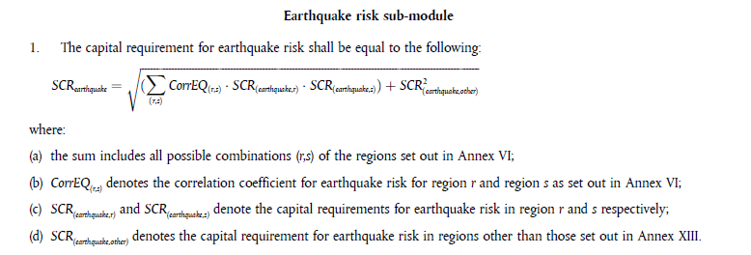
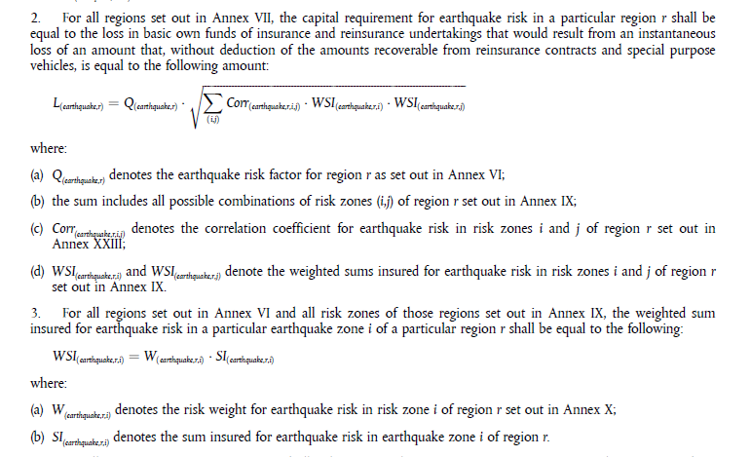
This is a rather complex process with several risk factors and coefficients spanning over to many different Annexes.

Slide 4
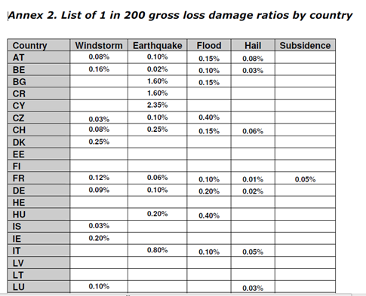
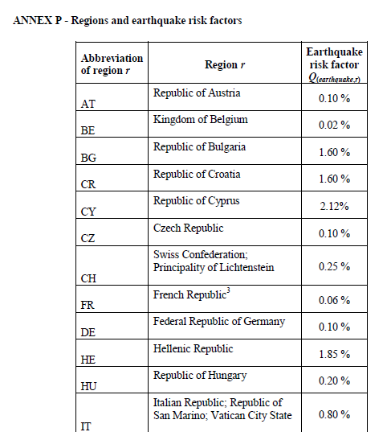

Points of consideration within the Standard Formula
Country risk factors seem to have been modified from 2010 to 2012
EIOPA-DOC-12/467
21 December 2012

Slide 5
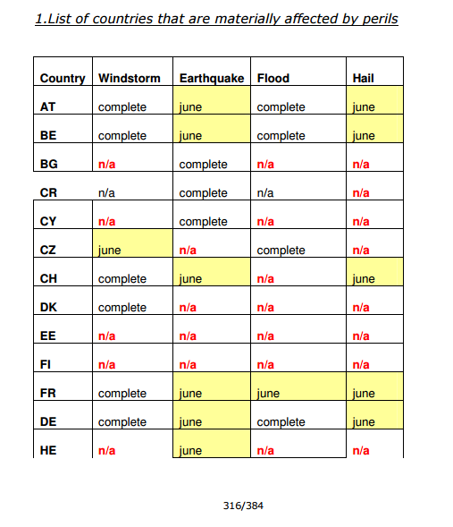
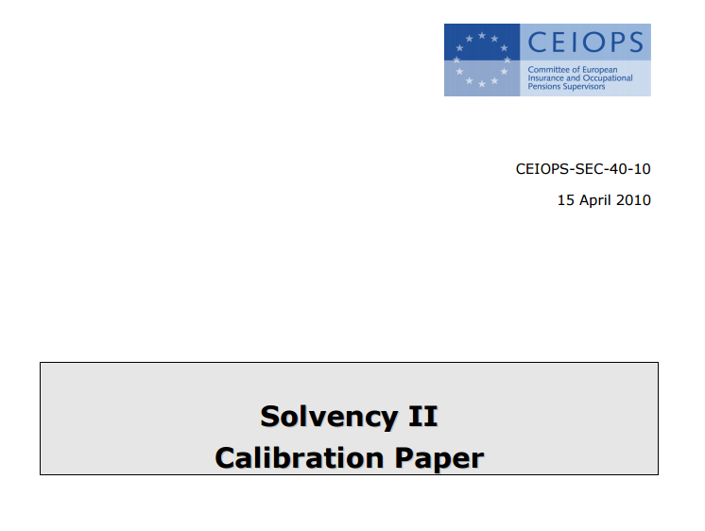
CEIOPS/EIOPA Steps for CAT RISK
(Earthquake risk in Greece as a case study)
15/4/2010: ΕIOPA released a calibration paper:
https://eiopa.europa.eu/Publications/QIS/CEIOPS-Calibration-paper-Solvency-II.pdf#search=solvency%20II%20calibration%20paper
Page 316 has a table stating that for Greece the rate will be calculated in June

Slide 6
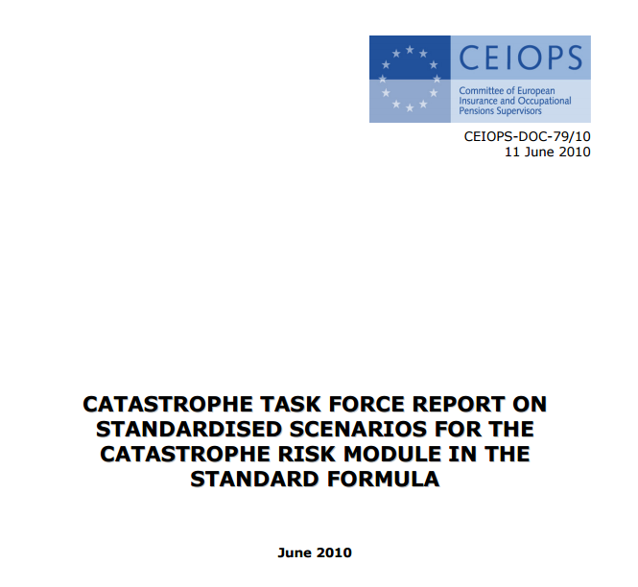
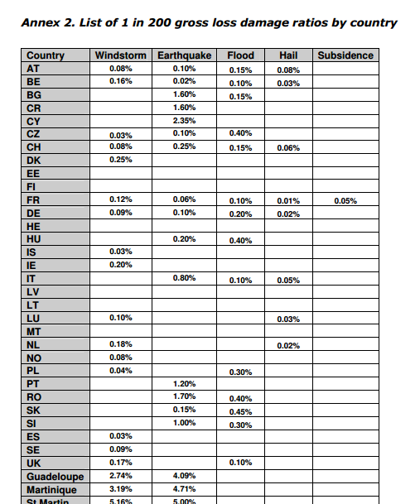
11/6/2010: CEIOPS set up a team called «CATASTROPHE TASK FORCE REPORT ON STANDARDISED SCENARIOS FOR THE CATASTROPHE RISK MODULE IN THE STANDARD FORMULA»
https://eiopa.europa.eu/CEIOPS-Archive/Documents/Reports/CEIOPS-DOC-79-10-CAT-TF-Report.pdf#search=CATASTROPHE%20TASK%20FORCE%20REPORT%20ON%20STANDARDISED%20SCENARIOS%20FOR%20THE%20CATASTROPHE%20RISK%20MODULE%20IN%20THE%20STANDARD%20FORMULA
Page 99 (Annex 2) Table for Greece (EL) there is still no rate (remained blank)

Slide 7
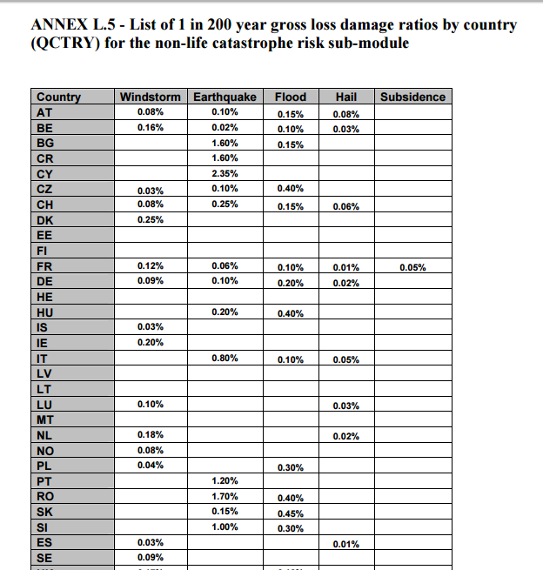
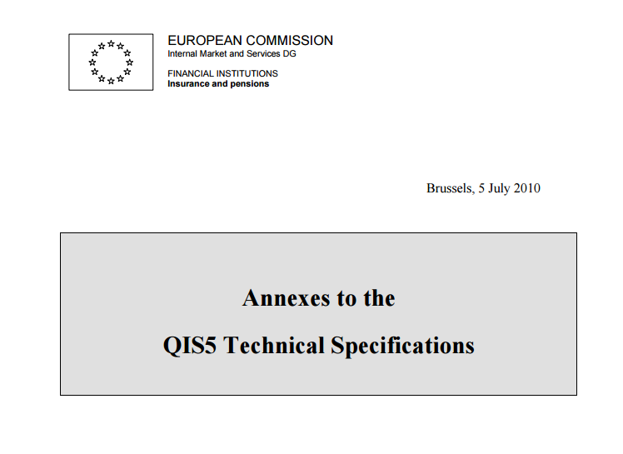
5/7/2010: «Annexes to the QIS5 Technical Specifications», is released whereas for Greece the rate is still empty (Annex L.5, page 42)
https://eiopa.europa.eu/Publications/QIS/Annexes-to-QIS5-technical_specifications_20100706.pdf#search=Annexes%20to%20the%20QIS5%20Technical%20Specifications

Slide 8
When the QIS5 was released (5th quantitative impact study) an excel spreadsheet was attached that incorporated all the earthquake coefficients
https://eiopa.europa.eu/Publications/Quantitative%20impact%20studies/QIS5-CAT-risk-parameters_en.xls
In the excel sheet «EQ_CRESTA_HE» for the first time the seismic risk country factor of 1,85% appears for Greece also with the cresta relativity factors and the correlation coefficients (see left column from the next slide)
However, afterwards the helper tab is released, but surprisingly the cresta relativity factors were not the same! (see right column from the next slide) Instead they were on average 3,3 times higher!!!
In the meantime the country risk factor remained the same. So by changing these cresta relativity factors there has been an average 3,3 fold increase on the weighting factors
In the final Delegation Act 2015/35, the Commission used the increased cresta relativity factors for Greece (right column next slide)
These are values that are hidden within numerous of Annexes so very few could actually take notice of them
What intervened between the lower and higher relativity factors for Greece? and what were the evidence for this change?

Slide 9
 | Market Factor
 | 1,85%
Cresta Zone | Cresta Relativity
'10' | 0,7
'11' | 0,6
'12' | 1,0
'13' | 1,1
'14' | 1,1
'15' | 0,6
'16' | 0,3
'17' | 0,7
'18' | 0,7
'19' | 0,5
'20' | 1,5
'21' | 0,7
'22' | 1,2
'23' | 1,0
'24' | 1,3
'25' | 1,3
'26' | 1,1
'27' | 2,0
'28' | 2,4
'29' | 1,9
'30' | 1,0
'31' | 2,0
'32' | 1,2
'33' | 2,3
'34' | 1,0
 | Market Factor
 | 1,85%
Cresta Zone | Cresta Relativity
'10' | 1,5
'11' | 1,5
'12' | 2,1
'13' | 3,2
'14' | 3,3
'15' | 1,6
'16' | 0,6
'17' | 1,9
'18' | 2,1
'19' | 2,3
'20' | 4,6
'21' | 1,9
'22' | 3,6
'23' | 3,0
'24' | 4,3
'25' | 4,0
'26' | 3,1
'27' | 6,4
'28' | 8,0
'29' | 6,8
'30' | 3,3
'31' | 7,2
'32' | 3,3
'33' | 7,6
'34' | 2,9
https://eiopa.europa.eu/Publications/QIS/QIS5-CAT-risk-parameters_en.xls
excel sheet «EQ_CRESTA_HE»
1.0=Mean value of the
Cresta Relativity for all Cresta zones
Country risk Factor remained the same 1.85%
However the mean cresta relativity value-Risk Weights increased 330% from 1 to 3,3!!!
Compare the values between both columns (left and right) they are very different (for example see 27 and 33 Cresta zones)
3.1=Mean value
of the Cresta Relativity
for all Cresta Zones
EIOPA helper tab
https://eiopa.europa.eu/Publications/QIS/H_CAT_NAT_20101005.xls

Slide 10
What is the role of the Country risk factors Qs in the equation and Annex VI?
Country risk Factors offer no added value, are misleading and currently the devil is in the detail (e.g. cresta relativity weights)
Beside the Greek example another example from Slovakia and Slovenia
SK Slovak Republic earthquake risk factor = 0,15 %
(So slovaks are happy with this low value, compared for example to Slovenians SL who have a country risk factor of 1.0% almost one order of magnitude higher)
However, the mean cresta relativity – Risk weight for Slovakia is 4.0!!! (with 23 out of the 24 zones having risk weight values from 1.4 up to 8.2!)
On the other hand, the mean cresta relativity – Risk weight of Slovenia is 0.88
Advice: do not believe what the country risk factor implies before you have a proper look at the cresta relativity weights

Slide 11
Credibility / scientific soundness of current
Cat Risk data
Country correlation for earthquake risk
  (ANNEX VI DELEGATED REGULATION (EU) 2015/35)
Correlation coefficients for earthquake risk for cresta zones
(ANNEX XXIII DELEGATED REGULATION (EU) 2015/35

Slide 12
EARTHQUAKE RISK CORRELATION COEFFICIENTS
FOR REGIONS
(case study Greece – Bulgaria)
Greece and Bulgaria are 25% correlated for seismic risk
ANNEX VI DELEGATED REGULATION (EU) 2015/35

Slide 13
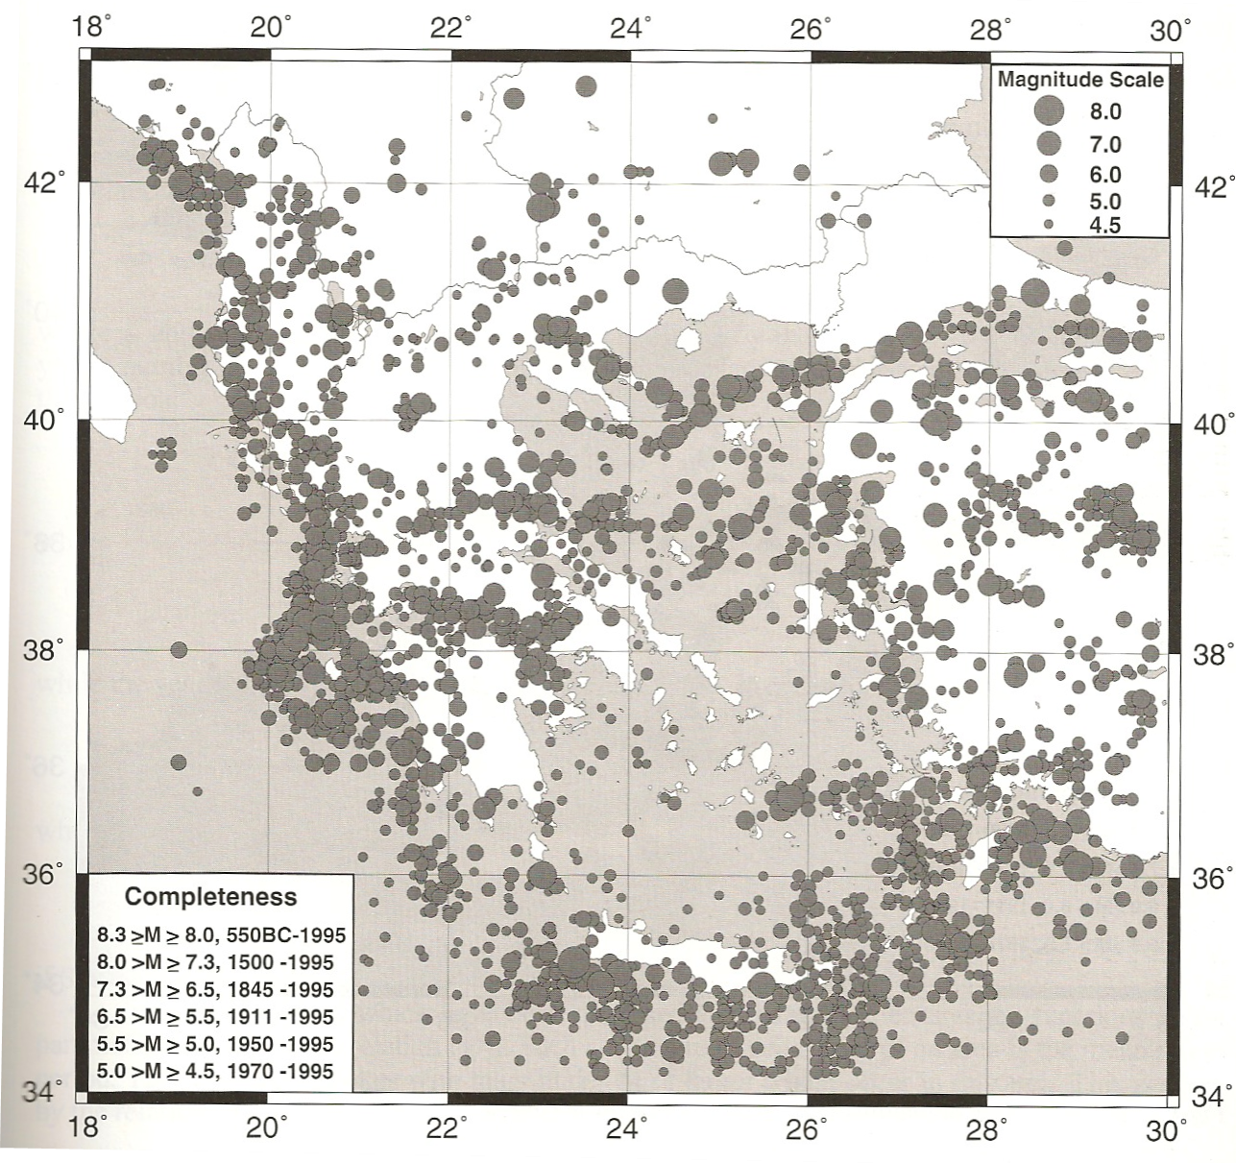
Seismicity of the Aegean
They are neighboring countries, but the seismicity of Greece near the borders with Bulgaria is very low not exceeding 2% of the total seismic energy release in Greece.
In addition, major active faults are predominantly E-W trending in both Northern Greece and Bulgaria so there is no major cross border continuation of active faults to support any strong correlation between both countries.
So the 25% correlation is a clear overestimate regarding Bulgaria.
Papazachos et al. (2000)

Slide 14
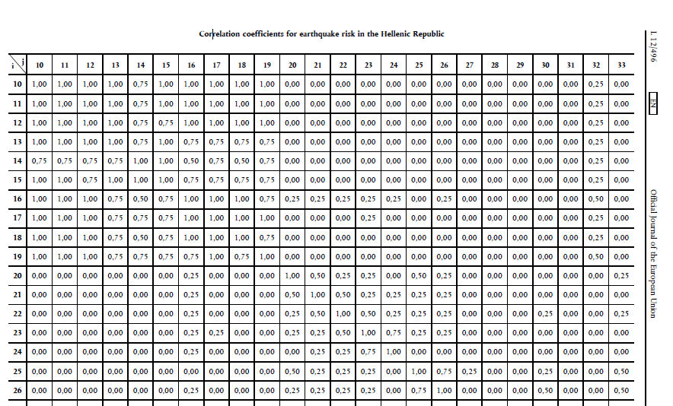
Correlation coefficients for earthquake risk for cresta zones in Greece
(ANNEX XXIII DELEGATED REGULATION (EU) 2015/35

Slide 15
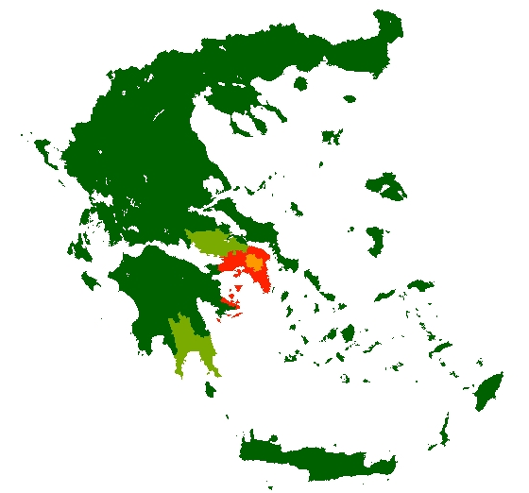
Maps showing spatially the correlations among different cresta zones in Greece
Maps extracted from a GIS (Geographical Information System)
Map Legend
Red =1.0
Orange= 0.75
Yellow =0.50
Light Green=0.25
Green= 0 - No correlation
Zone 17
Red entire Attica region
but not at the centre of Athens (against any scientific data)

Slide 16
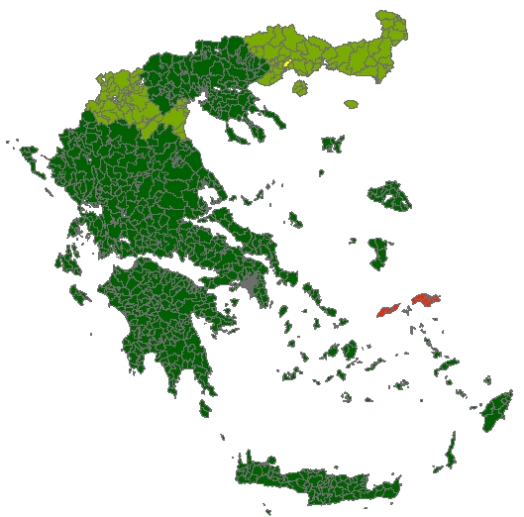
Maps showing spatially the correlations among different cresta zones in Greece
Maps extracted from a GIS (Geographical Information System)
Zone 83
Red Samos and Ikaria islands
Unacceptable correlation with Cresta zones from NE and NW part of Greece

Slide 17
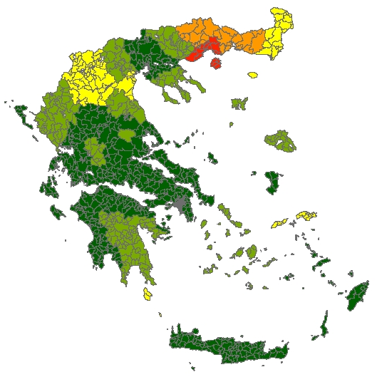
Maps showing spatially the correlations among different cresta zones in Greece
Maps extracted from a GIS (Geographical Information System)
Zone 65 Kavala
???
Half of the country is influenced in a weird pattern
Unacceptable

Slide 18

Maps showing spatially the correlations among different cresta zones in Greece
Maps extracted from a GIS (Geographical Information System)
Zone 50
Kozani
This is also in disarray with the damage pattern of the recent 1995 Ms=6.6 Kozani - Grevena earthquake (see next slide)
Half of the correlation zones (NE Greece, Eastern Macedonia - Thrace, Central Greece - Karpenisi, Ikaria and Samos islands Eastern Aegean) have not even felt the 1995 earthquake which was the strongest ever recorded in the Kozani – Grevean area

Slide 19
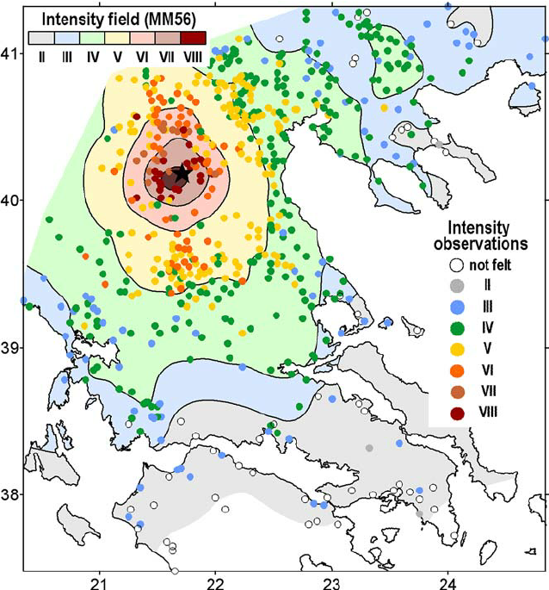
Damage pattern of the 1995 Ms = 6.6 Kozani – Grevena Earthquake (expressed in Earthquake intensities)
We have a recent earthquake from this cresta zone to compare the damage pattern and the findings with the correlation of the previous slides
Schenkova et al. 2007 Journal of Seismology

Slide 20
Points of consideration regarding Internal models
Greece: Earthquake analysis - Gross losses
from 4 Catastrophe models: Probable maximum losses
Total sum insured (Value of total residential portfolio) | RMS RiskLink 9.0 | IF Elements 4.8.0.6 | AIR Clasic2 12.0 | EQE Enterprise 3.13
PML as % of total sum insured 1 in 200 years (0.5%) | 1.03% | 2.21% | 1.31% | 3.80%
 | €10,637,701,731 | €23,841,997,128 | €13,057,349,229 | €40,795,553,276
Petseti and Nektarios (2012)
Each of the models provides significantly different results
Which of the models would be more attractive for insurers?
Could it create a conflict of interest or adverse selection?

