Slide 1
Flood risk Hungary
Gabriella Merész

Slide 2
Flood Risk exposure in Hungary
Notes:
Regarding the available data from national QIS2013, the Fire and other damage to property and Casco LOBs have the most exposure in zone City of Budapest (28 000 billion HUF appr. 90 billion EUR) and Pest county (11 000 billion HUF appr. 35 billion EUR).

Slide 3
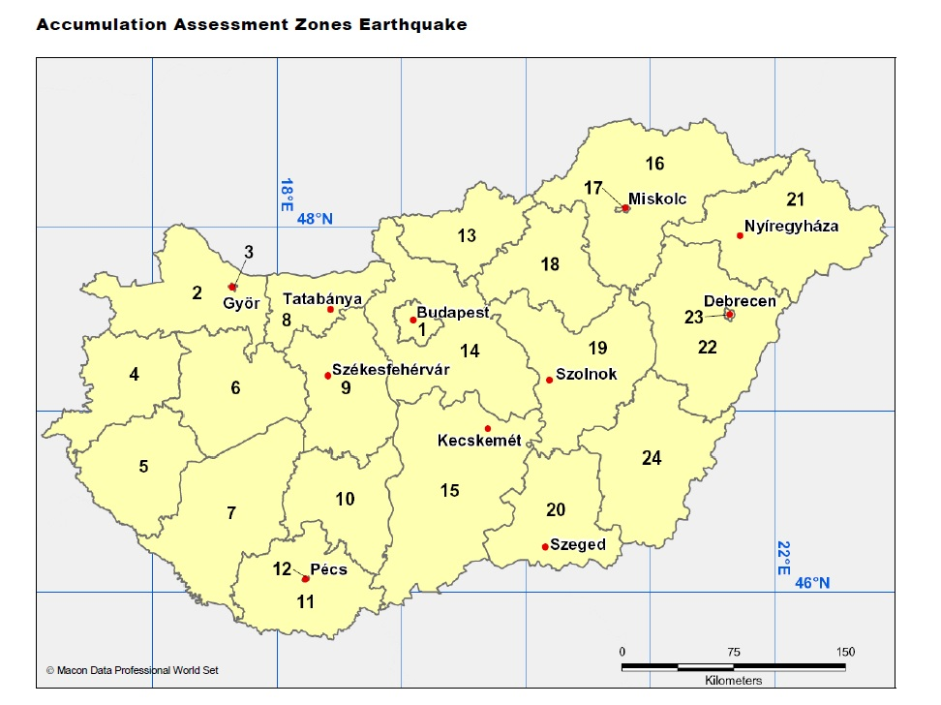
Cresta zones in Hungary
Notes:
Cities like Győr, Pécs, Debrecen and Miskolc are having own CRESTA zone factors (W), but some others like city of Szeged is included in zone Csongrád (20).

Slide 4
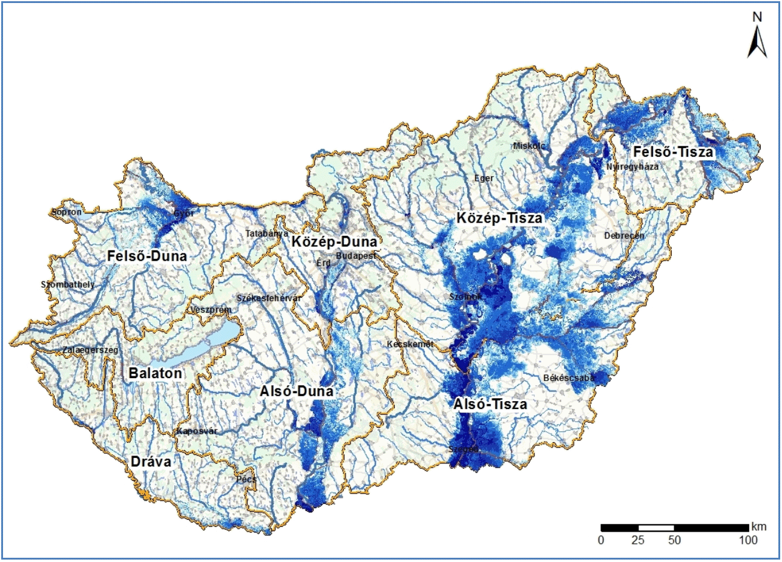
Flood map of Hungary
Notes:
This is the low probability floods map of Hungary. Low probability means probaility of flood is under 0.001.
„Directive 2007/60/EC of the European Parliament and of the Council on the assessment and management of flood risks requires Member States to carry out preliminary risk assessment, to prepare flood threat- and flood risk maps, and to take measures to reduce and manage flood risks. Such work started under the co-ordination of the General Directorate of Water Management in Hungary in 2010.”
http://ddvizig.hu/en/korabbi-hirek-1-en/65b9a93a-1577-42cc-a833-313a2c2179ff

Slide 5
CRESTA factor in Hungary
 | Cresta Relativity (W) | Cresta zone
City of Budapest | 0,6 | 1
Győr-Sopron | 0,9 | 2
City of Győr | 13,7 | 3
Vas | 0,6 | 4
Zala | 0,0 | 5
Veszprém | 0,0 | 6
Somogy | 0,2 | 7
Komárom | 0,2 | 8
Fejér | 0,0 | 9
Tolna | 0,3 | 10
Baranya | 0,1 | 11
City of Pécs | 0,0 | 12
Nógrád | 0,0 | 13
Pest | 0,2 | 14
Bács-Kiskun | 0,3 | 15
Borsod-Abaúj-Zemplén | 0,7 | 16
City of Miskolc | 0,0 | 17
Heves | 0,1 | 18
Szolnok | 2,4 | 19
Csongrád | 19,9 | 20
Szabolcs-Szatmár | 0,7 | 21
Hajdú-Bihar | 0,3 | 22
City of Debrecen | 0,0 | 23
Békés | 0,4 | 24
There are 2 relatively high W factors in Hungary: City of Győr and Csongrád.
One MTPL insurer stated that the standard formula calculation results three times higher scr than the reinsurers calculation at 1/200 safety level.

Slide 6
Cresta factor along the Danube
Taking in account major losses occurred at last big floods in German cities and the relatively small losses in Hungarian zones.
 | Cresta Zone factor
City of Győr (C3) | 13,7
Csongrád (C20) | 19,9
Passau | 1,5
Regensburg | 2,3
Notes:
What are the major differences among Cresta Zone factors cited above.
Why are Hungarian factors above nearly 10 times higher?

Slide 7
Q and highest W factors
Country | Q | Number of zones | zone | W | Q*W | 10+
Austria | 0.125% | 50 | Unken | 4.6 | 1% | 0
Czech Republic | 0.3% | 57 |  | 4.8 | 1% | 0
France | 0,1% | 75 | Ville-de-Paris | 6.2 | 1% | 0
Italy | 0.1% |  |  | 8 | 1% | 0
Slovakia | 0.45% | 4 |  | 3.8 | 2% | 0
Germany | 0.2% | 56 | Koblenz | 6.0 | 1% | 0
Romania | 0.4% | 6 | Braila | 11.9 | 5% | 1
UK | 0.1% |  | Hereford | 19.5 | 2% | 2
Poland | 0.16% | 82 |  | 12.56 | 2% | 2
Hungary | 0.4% | 20 | Csongrád | 19.9 | 8% | 2
Notes:
One MTPL insurer stated that the standard formula calculation results three times higher scr than the reinsurers calculation at 1/200 safety level. And reinsurer’s calculation shows that the main catastrophe risk is earthquake, but in SF results flood risk is six times higher than earthquake. This implies that 90% of this insurer’s flood risk is come from the 10% sum insured (Csongrád).

