Slide 1
Call to discuss EC’s Omnibus simplification package on sustainability reporting
3 March 2025

Slide 2
Background – Level 1 measures
Competition compliance policy statement, to be respected at all times: STATEMENT.
On 26 February, the European Commission presented its first Omnibus package of proposals to simplify EU rules on sustainability reporting and boost competitiveness, and unlock additional investment capacity, covering: CSRD, CSDDD, EU Taxonomy, Carbon Border Adjustment Mechanism Regulation, InvestEU Regulation.
The EC’s legislative proposals will now be submitted to the European Parliament and the Council for their consideration and adoption; a timeline for this has not been provided yet.

Slide 3
Background – Level 2 measures
In its first Omnibus package, the EC committed to revise the delegated act establishing the ESRS, with the aim of substantially reducing the number of data points, clarifying provisions deemed unclear, improving consistency with other pieces of legislation and reducing the number of data points.
Consequently, after meeting with EC officials, EFRAG Sustainability Reporting Board committed to participate in the proposed simplification process for the successful implementation of the relevant, reliable and proportionate sustainability-related data environment needed to meet the sustainable development and sustainable finance objectives of the EU: here.
Additionally, within the first Omnibus package, the EC has prepared a Draft implementing regulation to amend certain EU Taxonomy Delegated Acts, namely:
Disclosures Delegated Act
Climate Delegated Act
Environmental Delegated Act
The EC has launched a 4-week public consultation on its Draft implementing regulation, for stakeholders’ feedback for until 26 March. The EC plans to adopt the implementing regulation in Q2 2025, and it should apply from 1 January 2026.

Slide 4
Key changes proposed by the EC about the CSRD
Level 1 - Modification of the scope: Apply CSRD only to large undertakings with more than 1000 employees (i.e. undertakings that have more than 1000 employees and either a turnover above EUR 50 million or a balance sheet total above EUR 25 million). Additionally, a 2-year delay in implementation is granted for “phase 2” and “phase 3” companies.
Level 1 - Deletion of sector-specific standards requirement: The proposal will delete the empowerment for the Commission to adopt sector-specific standards.
Level 1 - Removing reasonable assurance requirement: The proposal removes the possibility for the Commission to propose moving to a reasonable assurance requirement.
Level 2 - Substantially reduce number of data points: The Commission will revise the ESRS to substantially reduce number of data points, add clarity and improve consistency with other legislation.

Slide 5
Key changes proposed by the EC about the CSDDD (level 1)
Postponing by 1 year (to 26 July 2028) the current transposition deadline (26 July 2027) and the first phase of the application of the sustainability due diligence requirements, covering the largest companies.
Deleting the review clause on inclusion of financial services in the CSDDD scope.
Limiting due diligence requirements to Tier 1 business partners.
Deleting EU civil liability provisions.
Keeping mandatory transition plans but simplifying requirements by aligning with those in the CSRD.

Slide 6
Key changes proposed by the EC about the EU Taxonomy
Level 1 - EU Taxonomy reporting made optional for companies under 1000 employees and 450 million EUR turnover (i.e. EU large companies corresponding to the CSDDD scope).
Level 2 - EU Taxonomy reporting burden to be reduced by: simplifying reporting templates to cut data points by 70%; introducing a financial materiality threshold; improving KPIs for financial institutions (with focus on Banks’ Green Asset Ratio); simplifying Do No Significant Harm criteria.

Slide 7
EC’s proposals to amend certain EU Taxonomy Delegated Acts (level 2)
It should be allowed for non-financial and financial undertakings not to assess compliance with the EU Taxonomy of activities that are not financially material for their business. This lack of materiality will be assumed if the cumulative value of activities is below 10% of the KPIs’ denominators.
Exposures of financial institutions to undertakings other than large undertakings which, on their balance sheet dates, exceed the average number of 1.000 employees in the financial year are excluded from the denominator of the applicable KPIs until the Commission’s review of the Disclosures Delegated Act is finalised.
General reporting templates are significantly shortened and simplified. Specific reporting templates on performance and exposures to fossil gas and nuclear activities are significantly reduced, focusing on elements not duplicative with general reporting templates.

Slide 8
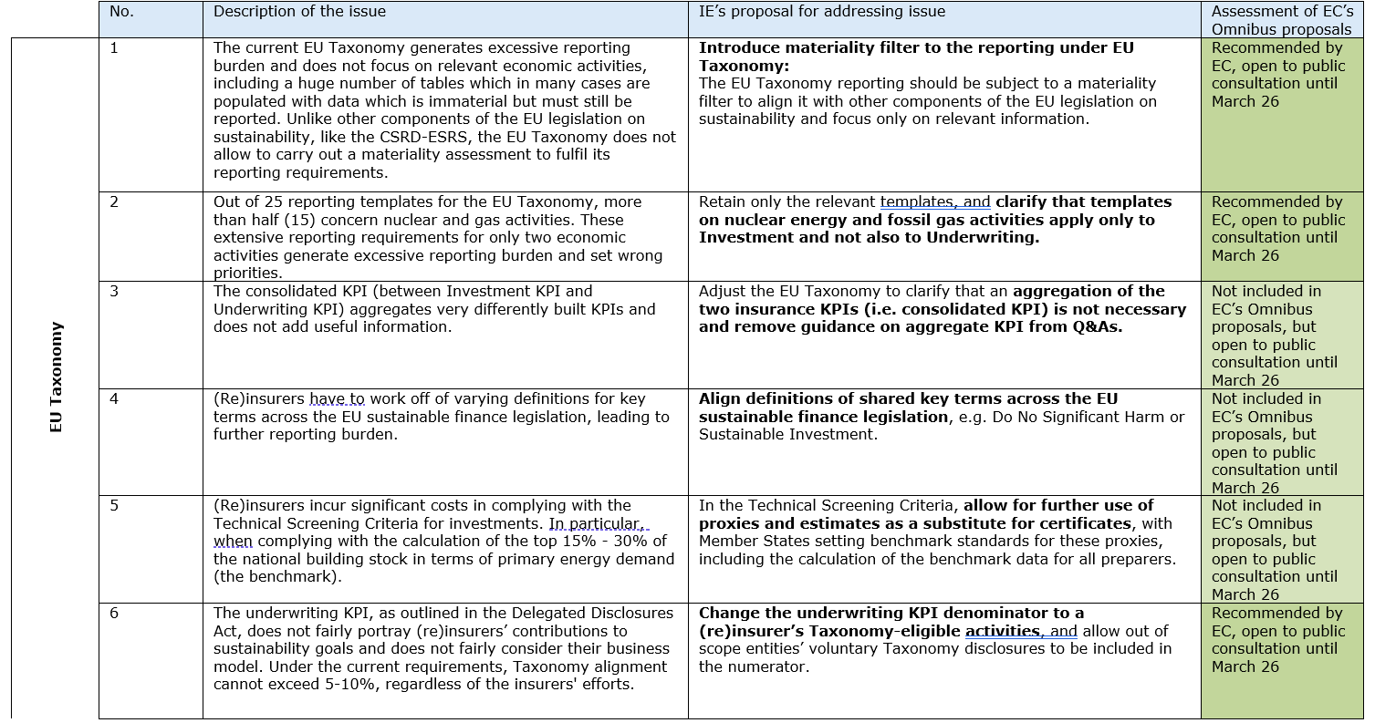
Mapping EC’s proposed changes with IE’s proposal for first Omnibus package (pt. I)

Slide 9
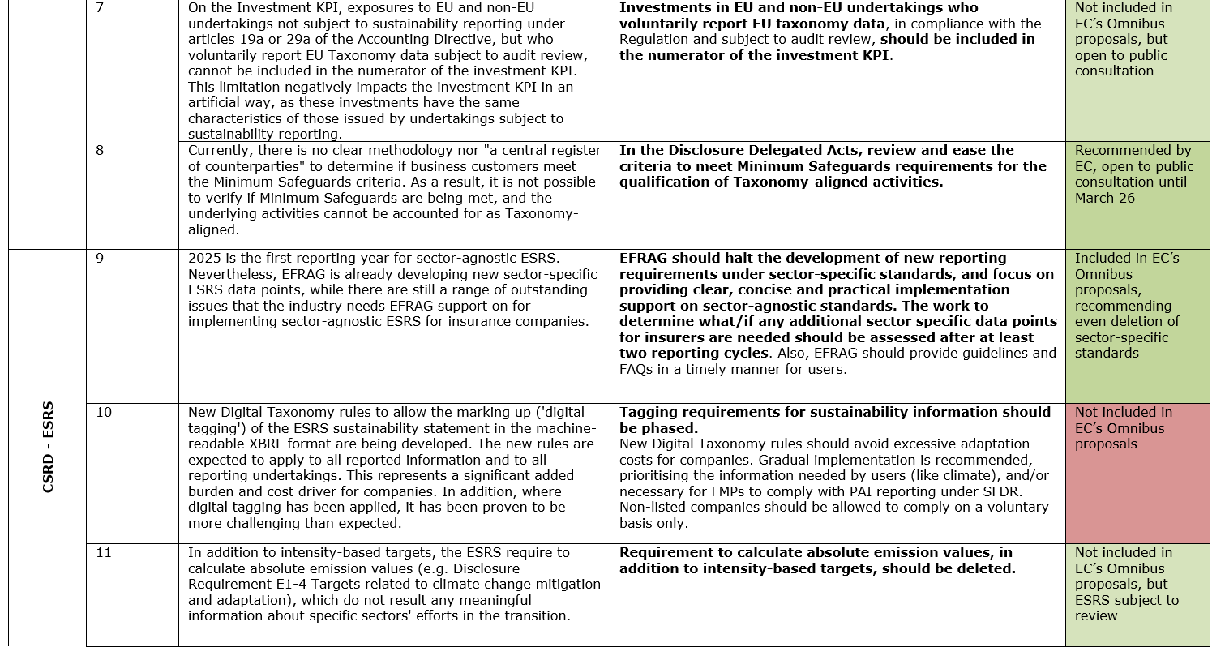
Mapping EC’s proposed changes with IE’s proposal for first Omnibus package (pt. II)

Slide 10
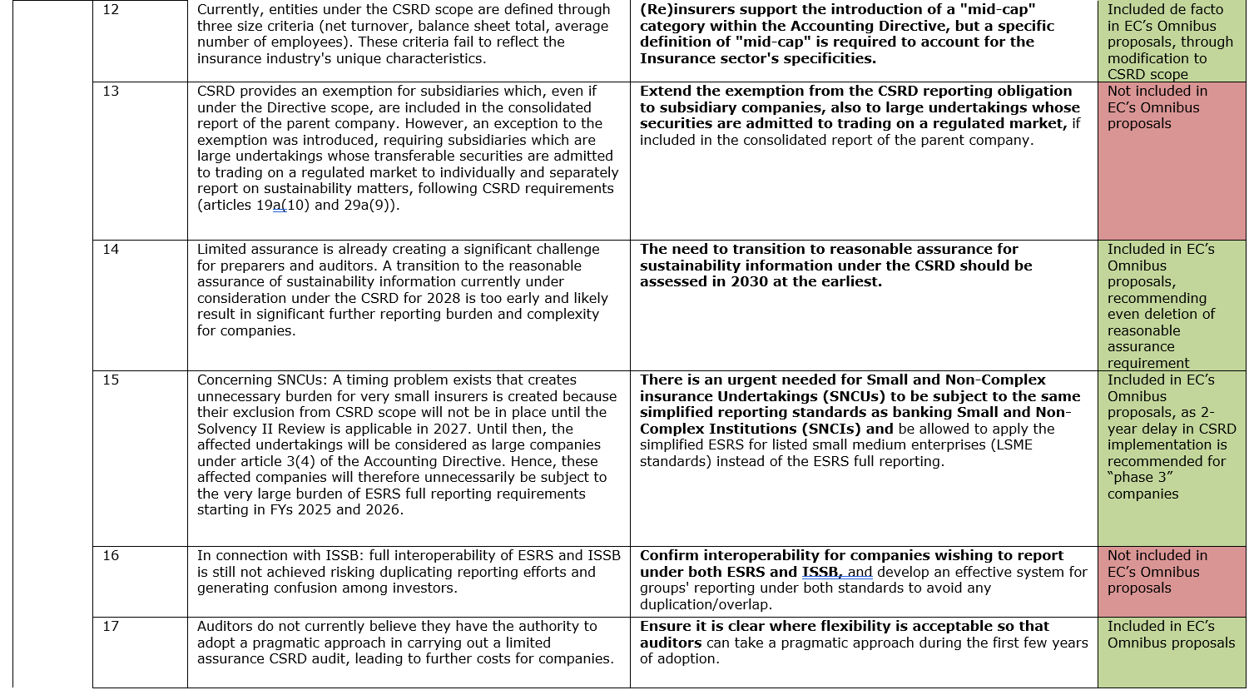
Mapping EC’s proposed changes with IE’s proposal for first Omnibus package (pt. III)

Slide 11
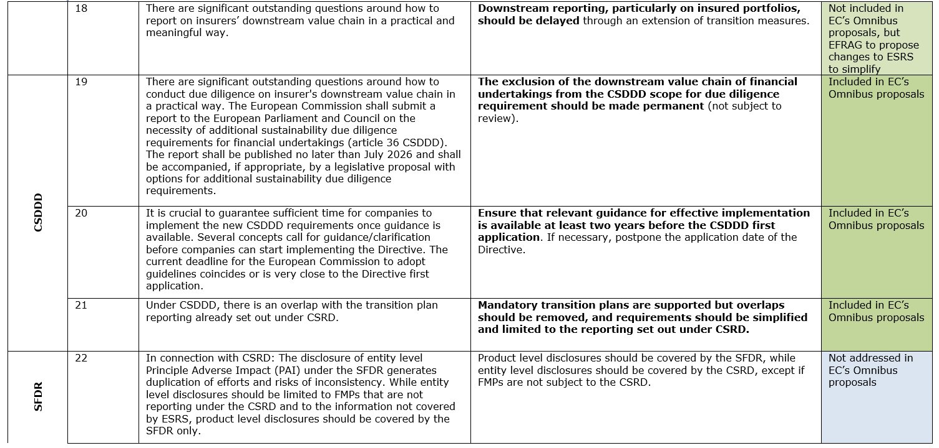
Mapping EC’s proposed changes with IE’s proposal for first Omnibus package (pt. IV)

Slide 12
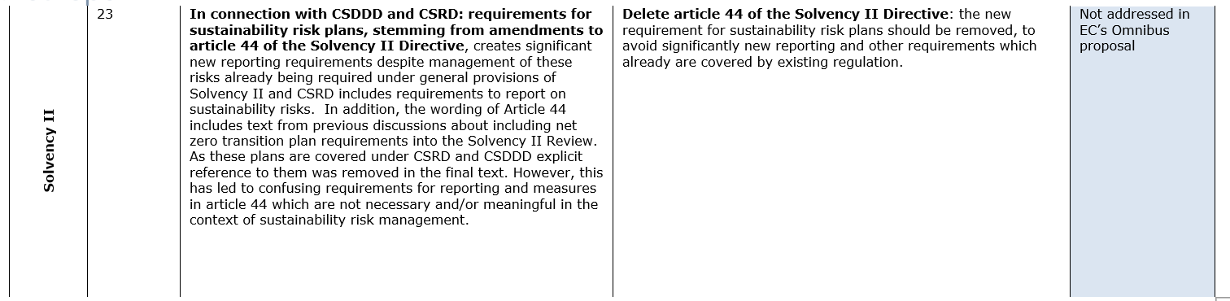
Mapping EC’s proposed changes with IE’s proposal for first Omnibus package (pt. V)

