Slide 1
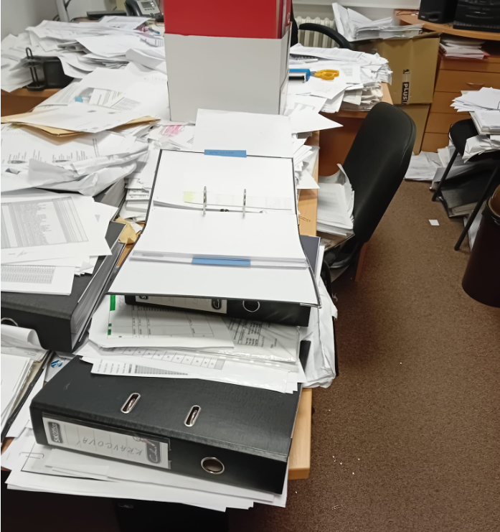
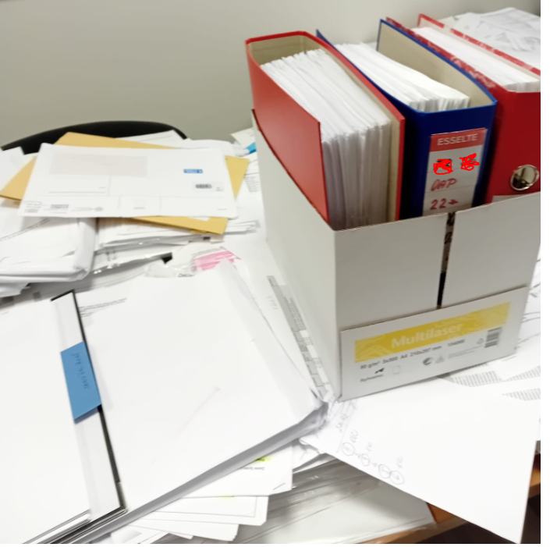
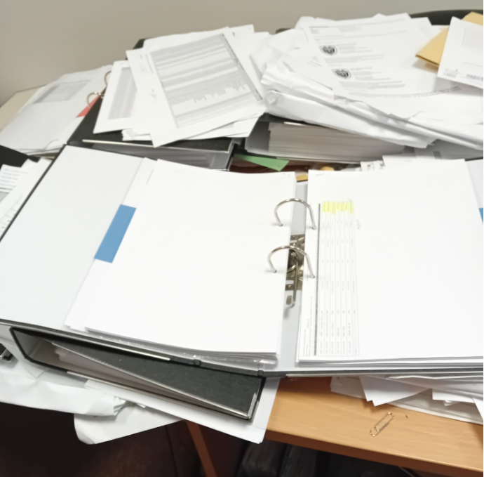
Webinár
Elektronická faktúra
9.9.2025

Slide 2
PRÍKLADY |FORMÁT| DORUČOVANIE| HARMONOGRAM
ZAOKRÚHĽOVANIE

Slide 3












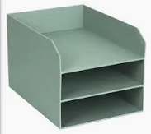

Evolúcia fakturácie
Peppol „box“
Peppol „box“
mailbox
maibox

Slide 4
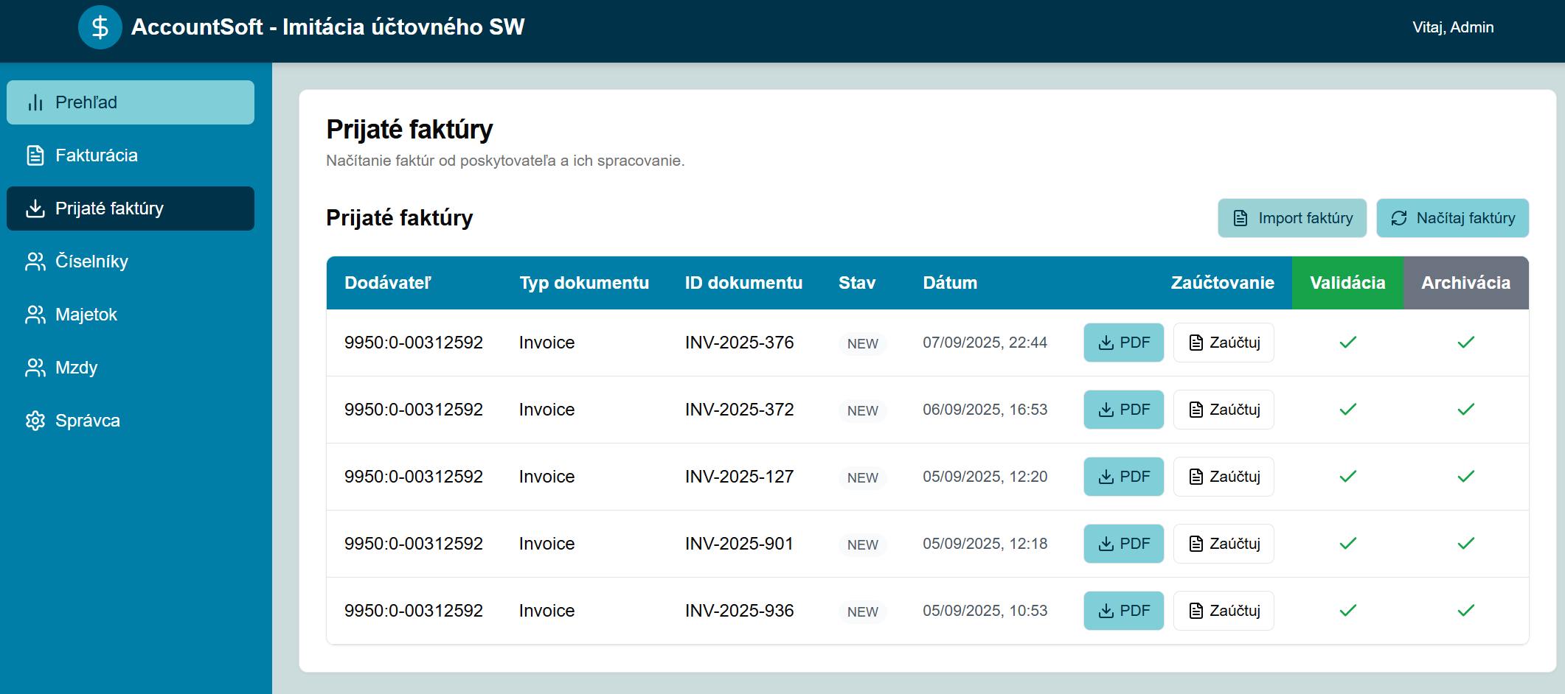

Slide 5



Slide 7


Notes:
Pri výmene dát medzi stranami sa musia tieto strany dohodnúť na formáte dát a na to, čo tieto dáta znamenajú. Ak ide iba do dvojstrannú dohodu tak si štandardne strany urobia zopár meetingov, dohodnú sa na štruktúra dát a obidve strany naimplementujú túto štruktúru do ich systémov
When data is exchanged between two parties, they need to agree upon the format and the meaning of that data. For a bilateral exchange, this agreement could be made in an ad-hoc manner; the parties have a few meetings, agree on some data structure, and both implement that data structure into their systems.

Slide 8



Notes:
This process, however, does not scale: if there are multiple parties communicating with each other, each with their own formats, the number of formats in use rises exponentially, and in many cases, which increases
the amount of work that needs to be done, as well as the number of mistakes that are made in implementation and operation

Slide 9



Štandard
Notes:
This is where standards are useful: in a bilateral exchange agreement, two parties can decide on which standards to use, thereby reducing the amount of work they need to do to implement the exchange. A community of parties can also agree to use the same standards, which would reduce that amount of work for everyone involved, including future community members. For instance, they can decide that all data exchange is done using XML, so that they can use standard software for building and parsing the data structure. Taking this one step further, they could also agree that the XML should have a fixed structure, with restrictions on the elements that may occur and what the values of those elements may be. If that is standardized, the parties know exactly which features they need to implement in order to exchange data with other parties that are using the same standard.

Slide 10
UBL
CII
Notes:
In the world of business document exchange, there have always been a lot of bilateral agreements, and small communities creating unique data formats for their data exchange needs. But often, the same type of information is exchanged; think of catalogues, orders, and invoices, to name a few. The realization that this led to a lot of duplicate effort gave rise to the creation of several efforts to define a standard format for business documents. Two of the more widely known are: • Universal Business Language (UBL) from Oasis [UBL] 3 • The Cross Industry formats from UN/CEFACT, such as the Cross Industy Invoice (CII) [CII]

Slide 11
XML Schéma
Aké XML „položky“ faktúry
V akom poradí
Ako často sa musia alebo môžu objaviť
Aké vlastnosti môžu „položky“ mať
Aké typy hodnôt môžu nadobúdať (čísla, text..)
UBL
Notes:
XML Schemas An XML Schema is a structural specification for XML documents: it defines which XML tags may occur, in which order, their cardinality (e.g. how often they must or may appear), which XML attributes the tags may have, and basic type information on their values (numbers, text, date, time, etc.). Many XML processing libraries and tools provide functionality to validate a given XML document against a specific schema. Section 5 contains more information on document validation.

Slide 12


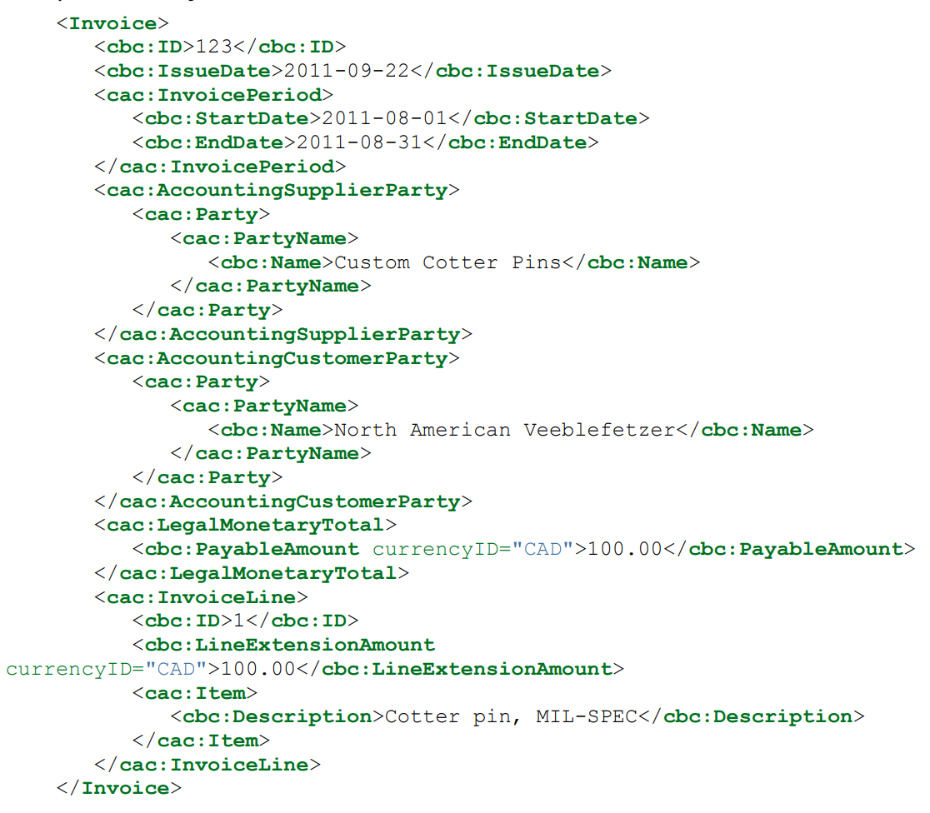
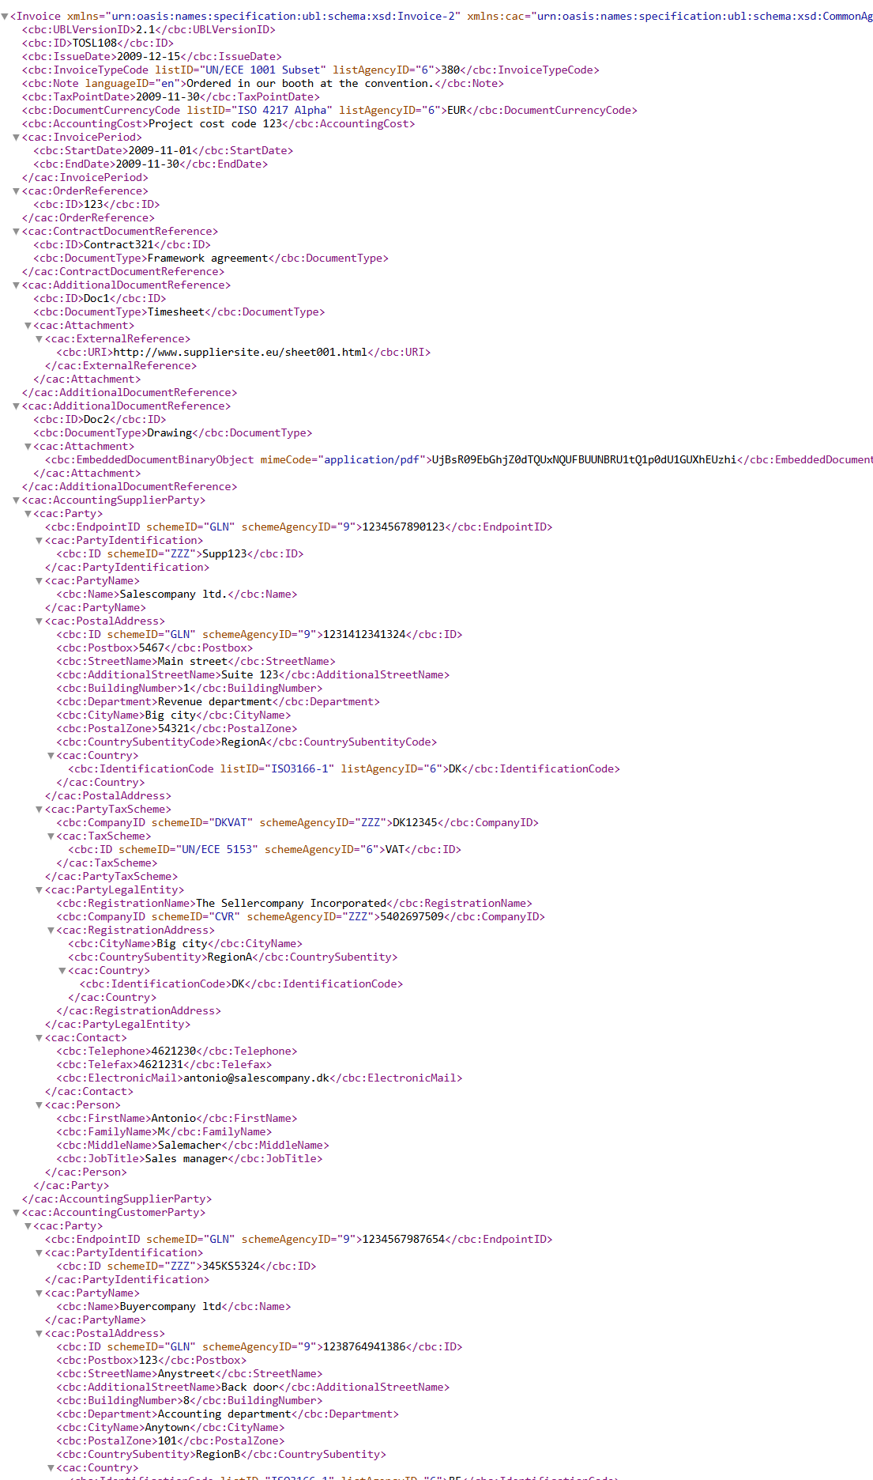
<cbc:CustomizationID>
Notes:
The problem with UBL (and CII) is that it is too broad; since they aim to cover most, if not all, business use-cases, they allow for many optional elements and data constructs that most businesses will never need.
That makes it easy to put whatever data you have into a valid UBL document, since you can choose the xml elements you want to use for that data. There is no need to use any of the other fields, so your implementation can be limited to those fields you have chosen.
However, if you’re the one receiving arbitrary UBL documents, you should be able to process all possible elements, as you don’t know which fields the sender uses, and what their values or constraints may be.
What happened next was that users of UBL would realize they really only used a small subset of UBL, say 100 to 200 possible elements. They’d agree amongst each other that certain fields were not to be used, others would be mandatory, and for some the values would be restricted to a limited set of options.
UBL Customizations UBL provides support for defining subsets of its elements, or other restrictions to valid documents. This is called a customization, and indicated through the UBL Element cbc:CustomizationID, which contains an identifier indication which customization is in use. Essentially, this is the element that shows which rules and restrictions the document is supposed to be compliant to, and each document type has a unique CustomizationID. A document can only have one CustomizationID.
This happened in many places, some because the creators were not aware of others, others because the creators did not agree on the choices of other dialects, and yet more simply because of the Not-Invented-Here effect. Just to name a few, there were UBL-OHNL, Peppol BIS (1/2), SI-UBL, XRechnung, OIOUBL, and many, many more.

Slide 13
<cbc:CustomizationID>
Notes:
The problem with UBL (and CII) is that it is too broad; since they aim to cover most, if not all, business use-cases, they allow for many optional elements and data constructs that most businesses will never need.
That makes it easy to put whatever data you have into a valid UBL document, since you can choose the xml elements you want to use for that data. There is no need to use any of the other fields, so your implementation can be limited to those fields you have chosen.
However, if you’re the one receiving arbitrary UBL documents, you should be able to process all possible elements, as you don’t know which fields the sender uses, and what their values or constraints may be.
What happened next was that users of UBL would realize they really only used a small subset of UBL, say 100 to 200 possible elements. They’d agree amongst each other that certain fields were not to be used, others would be mandatory, and for some the values would be restricted to a limited set of options.
UBL Customizations UBL provides support for defining subsets of its elements, or other restrictions to valid documents. This is called a customization, and indicated through the UBL Element cbc:CustomizationID, which contains an identifier indication which customization is in use. Essentially, this is the element that shows which rules and restrictions the document is supposed to be compliant to, and each document type has a unique CustomizationID. A document can only have one CustomizationID.
This happened in many places, some because the creators were not aware of others, others because the creators did not agree on the choices of other dialects, and yet more simply because of the Not-Invented-Here effect. Just to name a few, there were UBL-OHNL, Peppol BIS (1/2), SI-UBL, XRechnung, OIOUBL, and many, many more.

Slide 14

European Norm EN-16931
Nariadením EU 2014/55 sú orgány členských štátov povinné prijímať a spracovávať elektronické faktúry vo formáte, ktorý je v súlade s EN-16931
Notes:
At some point, there was a directed effort to improve this, at least for invoices at EU government organizations. This effort covered not just UBL-based invoice formats, but other formats as well: European Norm EN-16931 [EN-16931].
EN-16931 describes a semantic data model for “Core Invoices”; e.g. it defines a set of business terms for an invoice, and a set of business rules that compliant documents must adhere to. It also defines mappings for that semantic model to UBL and CII (and EDIFACT, but EDIFACT is very different from the others).
EN-16931 came with EU Directive 2014/55, which dictates that member states adopt it so that it will become mandatory for all public contracting authorities and contracting entities to receive and process eInvoices complying with EN16931.

Slide 15
European Norm EN-16931
Význam jednotlivých elementov– sémantika
Ako často sa môžu / majú použiť – kardinalita
Business pravidlá (suma položiek = sume faktúry)
Mapovanie na UBL a CII - syntax
Notes:
At some point, there was a directed effort to improve this, at least for invoices at EU government organizations. This effort covered not just UBL-based invoice formats, but other formats as well: European Norm EN-16931 [EN-16931].
EN-16931 describes a semantic data model for “Core Invoices”; e.g. it defines a set of business terms for an invoice, and a set of business rules that compliant documents must adhere to. It also defines mappings for that semantic model to UBL and CII (and EDIFACT, but EDIFACT is very different from the others).
EN-16931 came with EU Directive 2014/55, which dictates that member states adopt it so that it will become mandatory for all public contracting authorities and contracting entities to receive and process eInvoices complying with EN16931.

Slide 16
European Norm EN-16931
Customisations
Norma tiež popisuje ako je možné štruktúrovane vytvoriť viac špecifické varianty vo forme „Core Invoice Usage Specifications (CIUSes)
CIUS môžu
odstrániť nepovinné polia
zmeniť nepovinné polia na povinné
vydať striktnejšie business pravidlá
zúžiť existujúci Code list – použiť iba subset
CIUS nesmú
rozširovať Code listy o hodnoty
pridávať elementy
urobiť z povinných poli nepovinné
poľavovať z business pravidiel
Peppol BIS 3 je CIUS EN normy. Preto každá platná Peppol BIS faktúra je tiež v súlade s EN-16931.

Slide 17
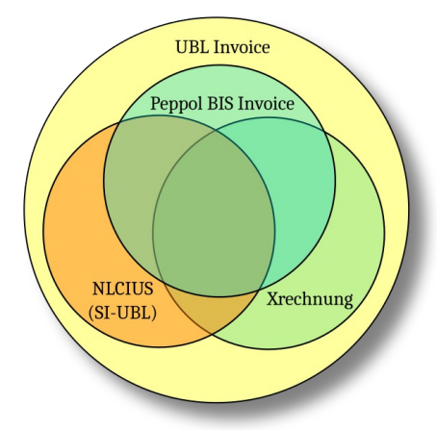
EN-16931
Core Invoice Usage Specifications’ (CIUSes)
But not ideal ☺

Slide 18


Invoice extracts....
<Invoice xmlns="urn:..invoicetyp1"><cbc:verzia>2.1
<cbc:CustomizationID>KIA_faktura_self_bill
<cbc:ID>INV-2025-001
<cbc:datumVystavenia>15.05.2025
<cbc:datumSplatnosti>2025-06-14
<cbc:poznamka>Ďakujeme za Vašu skorú platbu.
<cbc:datumZdPlnenia>2025-05-10
<cac:objednavkaCislo><cbc:ID>INV-2025-001
<cac:nazovDodavatela>Sub AB a.s.
.......
KIA_faktura_self_bill
<Invoice xmlns="urn:..invoicetyp2"><cbc:verzia>2.4
<cbc:CustomizationID>Slovnaft_faktura
<cbc:ID>INV-2025-001
<cbc:datumVyst>2025-05-15
<cbc:datumSpl>2025-06-14
<cbc:pozn>Ďakujeme za Vašu skorú platbu.
<cbc:datumZdPln>2025-05-10
<cac:objCislo><cbc:ID>INV-2025-001
<cac:nazovDod>Sub AB a.s.
.......
Sub AB
Slovnaft_faktúra

Slide 19
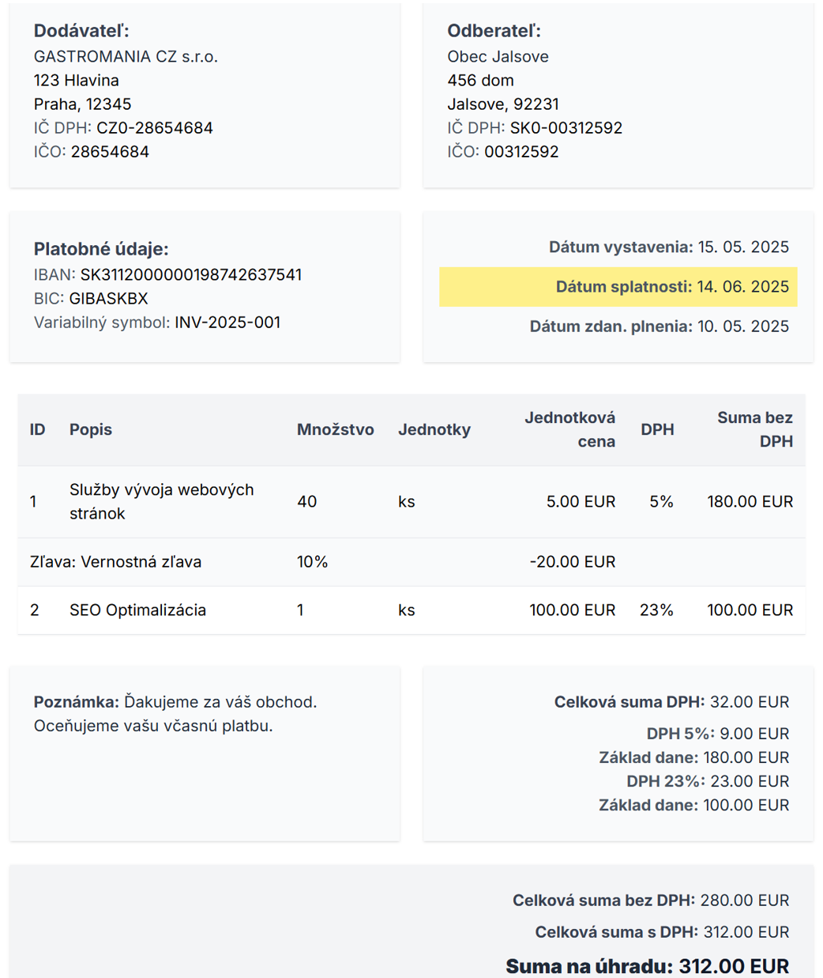
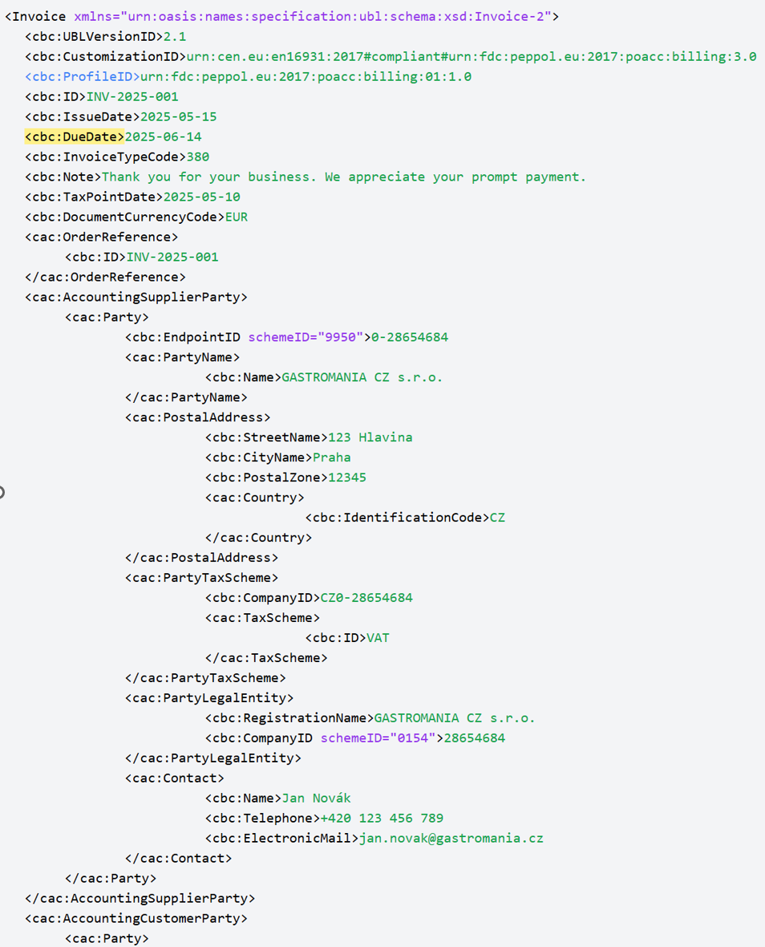
PEPPOL BIS faktúra

Slide 20
Štartovací manuál k Peppol formátu
Stručná história EDI
Prečo vznikol UBL
Aký má UBL problém
Čo je EN 16931
Semantický model a mapovanie na syntax
Povolené úpravy EN 16931
Ako čítať Peppol BIS špecifikáciu
Ako validovať faktúru
Ako začať s implementáciou v účtovných systémoch
Dvojklikni na dokument pre otvorenie

Slide 23


PEPPOL BIS faktúra
Kia
EDI server IT firmy 1
PEPPOL BIS faktúra
Slovnaft
Sub AB
EDI server IT firmy 2
PEPPOL BIS faktúra
Jaguar
EDI server IT firmy 3

Slide 24



KIA
Sub AB

Slide 25
Slovnaft
Sub AB

Slide 26
Jaguar
Sub AB

Slide 27

V akom zozname
nájdem odberateľa?
Kto je odberateľov digitálny poštár?
Odovzdá faktúru
Sprístupnenie faktúry
KIA
Sub AB a.s.
Digitálny poštár
SMP (zoznamy)
SML (adresy zoznamov)

Slide 28
Každá zdaniteľná osoba, ktorá je povinná vyhotoviť elektronickú faktúru podľa tohto zákona, je povinná zabezpečiť, aby mohla zaslať a prijať elektronickú faktúru doručovacou službou. Každá osoba, ktorej je v tuzemsku dodaný tovar alebo služba, pri ktorej je zdaniteľná osoba povinná vyhotoviť elektronickú faktúru podľa tohto zákona, je povinná zabezpečiť, aby mohla prijať elektronickú faktúru zaslanú doručovacou službou.
Finančné riaditeľstvo zapíše do evidencie doručovací štandard, ktorý je všeobecne akceptovaný a rozšírený v členských štátoch.

Slide 29
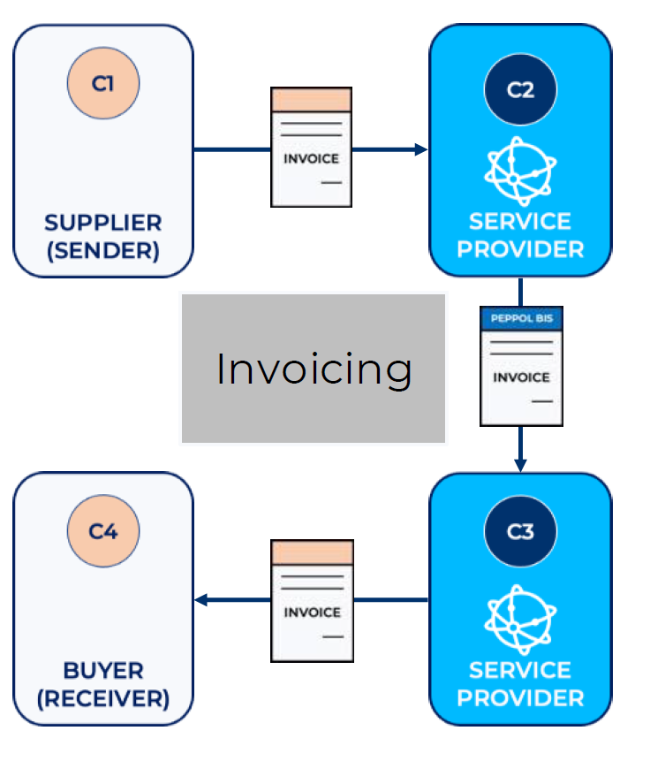

Slide 30
 | Popis systému | Vlastník
 | SML (Subscriber Metadata Locator) – služba založená na DNS princípe. Zjednodušene väzba medzi Peppol ID participanta (DIČ) a URL SMP | Európska Komisia
 | SMP (Subscriber Metadata Provider) – Lookup and Discovery služba. Zjednodušene väzba medzi ID participantom (DIČ) a „Poštárom“ | Finančná správa SR
 | AP (Access Point) Service provider aka Digitálny poštár. Firma poskytujúca službu prístupu k sieti Peppol. | Súkromná sféra

Slide 31
Certifikovaný poskytovateľ doručovacej služby (Digitálny poštár / Access Point Service Provider)
Osoba môže v Slovenskej republike poskytovať doručovaciu službu ako certifikovaný poskytovateľ doručovacej služby, ak je zapísaná v evidencii na webovom sídle Finančného riaditeľstva
Doručovacou službou je služba zasielania a doručovania elektronickej faktúry, ktorú poskytuje certifikovaný poskytovateľ doručovacej služby.
Finančné riaditeľstvo zapíše do evidencie certifikovaného poskytovateľa doručovacej služby osobu, ktorá má sídlo alebo miesto podnikania v členskom štáte, je bezúhonná, preukáže splnenie podmienok podľa viď nižšie, preukáže oprávnenie poskytovať doručovaciu službu v súlade s podmienkami európskeho doručovacieho štandardu a s použitím nástrojov a postupov podľa tohto štandardu.
Certifikovaný poskytovateľ doručovacej služby je povinný zabezpečiť, aby prostredníctvom doručovacej služby bolo možné
automatizovane skontrolovať splnenie formálnych náležitostí elektronickej faktúry,
zabezpečiť vysokú úroveň spoľahlivosti identifikácie odosielateľa aj adresáta,
zabezpečiť vierohodnosť pôvodu, neporušenosť obsahu a čitateľnosť elektronickej faktúry od jej odoslania po jej doručenie adresátovi,
preukázať dátum a čas odoslania, doručenia a prijatia elektronickej faktúry,
automatizovane plniť informačné povinnosti podľa § 80, § 80a a 85n.

Slide 32
Harmonogram
2025
2026
2027
Q1
Q2
Q3
Q4
Q1
Q2
Q3
Q4
Q1
Q2
Q3
Legislatíva
Novelizácie a vyhlášky
1. 1. 2026 Platnosť
1. 1. 2027 Účinnosť
PA Slovensko (FS SR)
Akreditácia Digitálnych
poštárov
Digitálni poštári
(Poskytovatelia prístupu
k sieti Peppol)
Vývoj a certikácia AP
(Access Point) SW
Certifikácia OpenPeppol
Testovanie s SMP
„Adresný systém“
SMP
Obstaranie a prevádzka
APV (C5, SMP a KYC)
Obstaranie (C5, SMP, KYC)
Testy
Fakturačné a účtovné
systémy
Vystavovanie el. faktúr
Prijímanie el. faktúr
Archivácia el. faktúr
Analýza a dopadové štúdie
(Vystavovanie a prijímanie
faktúr vo formáte Peppol BIS3)
Implementácia a integračné
testy s AP
Pilot/Spustenie
9.9.2025

Slide 33
Nabudúce:
Oznamovanie extraktov z faktúr na roh C5
„Povinná“ pomôcka pre KYC proces počas Onboardingu firiem
Pokračovanie v zodpovedaní otvorených otázok

Slide 34
Užitočné linky
Projektová stránka Efaktúra https://www.info-efaktura.sk/
Imitácia účtovného systému integrovaného na testovaciu sieť Peppol https://uctovnysystem.vercel.app/
Prototyp aplikácie pre proces udelenia súhlasu Digitálnemu poštárovi https://kejwajsi.vercel.app/
Protyp aplikácie pre účtovné firmy https://fakturyfiriem.vercel.app/

Slide 35
Užitočné linky
Format faktúry: https://www.normoff.gov.sk/files/docs/e-fakturacia-stn-en-16931-1-a1-614d692fbcaa2.pdf
Peppol BIS 3 preklad do XML podla standardu UBL2.1: Peppol BIS Billing 3.0 - November 2024 Release
Praktické informácie o sieti Peppol a dostupnom open-source SW: Peppol Practical - News
OpenPeppol organizácia zastrešujúca EU štandard faktúry a digitálnu sieť Peppol: www.peppol.org

Slide 36
Back up slides

Slide 37
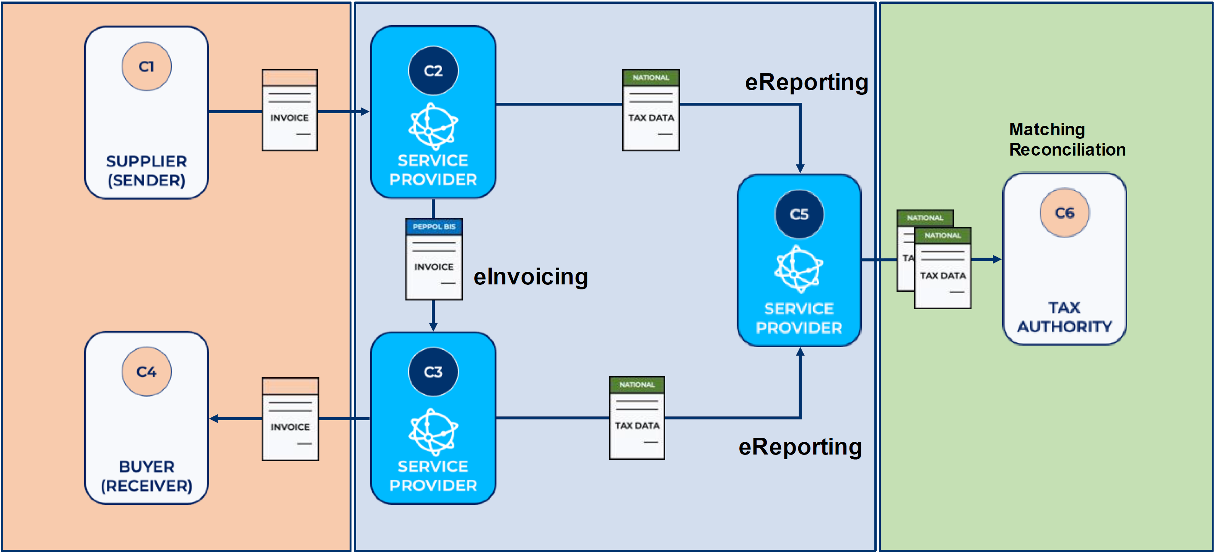
5 rohový Peppol model

Slide 38
Ak odberateľ nebude schopný prijať elektronickú faktúru doručovacou službou a dodávateľ zašle elektronickú faktúru doručovacou službou, u dodávateľa sa zákonná povinnosť vyhotoviť a zaslať elektronickú faktúru doručovacou službou považuje za splnenú.
Na zápis osoby ako certifikovaného poskytovateľa doručovacej služby do evidencie vedenej finančným riaditeľstvom podľa § 76a ods. 5 sa
v roku 2026 nevyžaduje preukázanie splnenia podmienky podľa § 76a ods. 2 písm. e) v rozsahu podľa § 85n ods. 10 až 12 v znení účinnom od 1. januára 2027,
do 30. júna 2030 vrátane nevyžaduje preukázanie splnenia podmienky podľa § 76a ods. 2 písm. e) v rozsahu podľa § 80 a 80a v znení účinnom od 1. júla 2030.
V § 72 ods. 11 sa navrhuje zákonná povinnosť pre dodávateľa vyhotoviť faktúru v inej podobe pri dodaniach tovarov alebo služieb, prípadne pri prijatí platby pred dodaním, ak je odberateľom tovarov alebo služieb Slovenská informačná služba alebo Vojenské spravodajstvo. Podobne, ak je dodanie tovarov alebo služieb utajovanou skutočnosťou, je spojené s utajovanou skutočnosťou alebo si vyžaduje utajovanú skutočnosť, bez ohľadu na to, kde je dodávateľ alebo odberateľ tohto dodania usadený, vyhotovuje sa pri tomto dodaní povinne faktúra v inej podobe.

Slide 39
Ak platiteľ neoznámil údaje v lehote z dôvodov preukázateľnej technickej poruchy na strane certifikovaného poskytovateľa doručovacej služby a údaje oznámil bezodkladne po odstránení tejto poruchy

Slide 40
Milestone | Answer
Me, as a C2, would like to know when I can consider the invoice to be sent to C3 | When C2 receives an AS4 ACK from C3 it is that C3 has correctly received "A nonspecified payload" from C2. So when receiving a positive AS4 ACK
Me, as a C2, would like to know when I can consider the invoice to be succsesfuly delivered to C3 | When C2 receives a Positive MLS from C3 it is that C3 has correctly received a payload that is in compliance with the Peppol Business Document Specification e.g. Peppol BIS Billing specification. So when receiving a positive MLS
Me, as a C3, would like to know when I can consider the invoice to be received by me C3 | As above from the C3 side. So when sending an AS4-ACK (using the semantic of "sent"/"received" and "sucessfully delivered", but depends on the below answer.
Me, as a C3 would like to know when I can consider the invoice to be succesfully delivered by me, C3 | When sending a positive MLS.
Me, as a C2 or C3, would like to know when can I consider the TDD to be delivered to C5 | The 6 corner model is the logically a 3x4 corner model where the Invoice is C1-C2-C3-C4. The TDD is logically C1-C2-C5-C6 or (C4-)C3-C5-C6, so the answers above on C2-C3 can just be repeated with C2 to C5 and C3 to C5

Slide 41
Response levels
C1
C2
C3
C4
End User
Delivered from C4 to C1 (via C3 and C2)
Business validity message and status
End User
Business Status
Compliant to local business rules
Peppol BIS Invoice Response (IR)
Peppol AP
Peppol AP
Delivered from C3 to C2
Peppol Message compliant message
Messaging Status
Compliant to Peppol Interoperability Framework, Structure and Business Rules
Message Level Sesponse (MLS)
AP Message Handler
AP Message Handler
AS4 ACK Delivered from C3 to C2
Peppol eDelivery compliant message
Protocol Status
Peppol eDelivery compliance and Peppol PKI compliance
Protocol status (AS4 ACK)
AP Protocol Handler
AP Protocol Handler

