Slide 1
Solvency II review
EIOPA’s inadequate proposal on risk margin and unnecessary proposal on risk-free interest rate undermine long-term investment

Slide 2
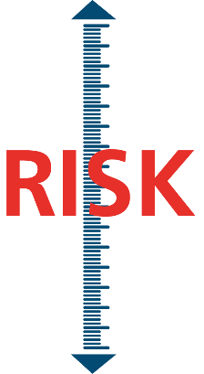



Concerns with valuation of liabilities
Risk margin is far too high and can also cause volatility
EIOPA proposal needs significant improvements
EIOPA proposal for risk-free rate methodology is unnecessary
RISK MARGIN
Both proposals will not lead to appropriate liability valuations
CURRENT RISK-FREE RATE METHODOLOGY IS APPROPRIATE
BUT
THE RISK MARGIN IS FAR TOO HIGH
RISK-FREE
INTEREST RATE

Slide 3
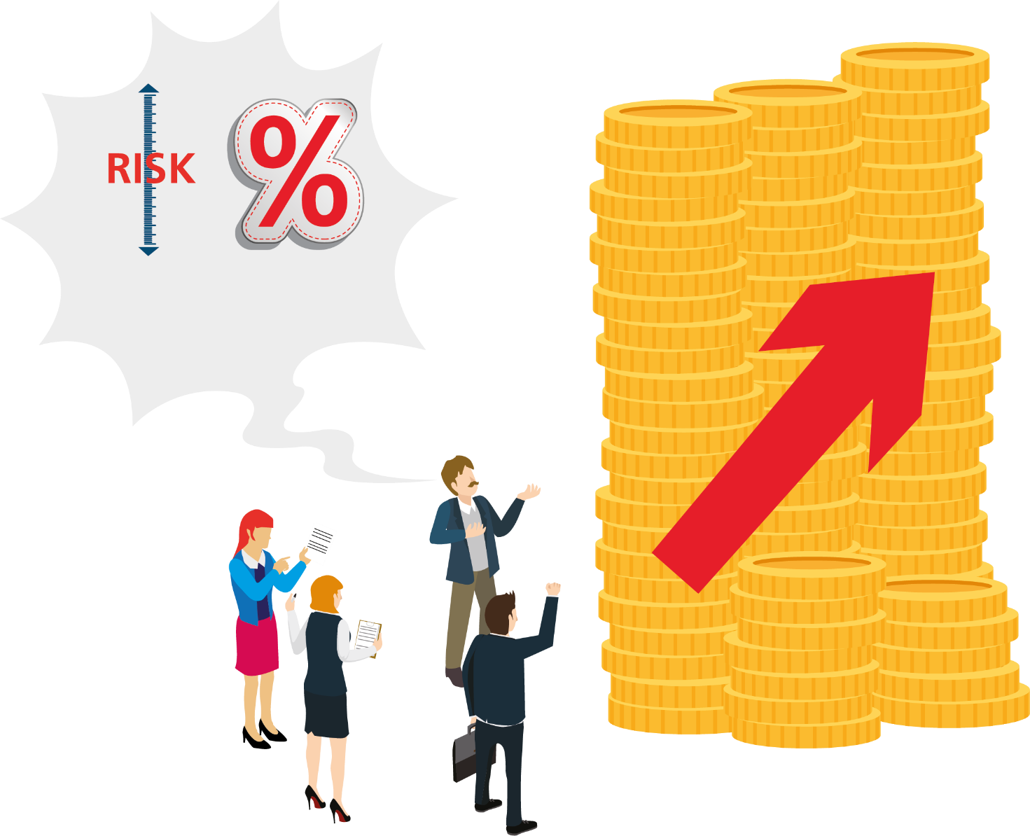
Solvency II review: more appropriate valuation of liabilities needed
A high risk margin and EIOPA proposal on risk-free rate exaggerate value of liabilities
RISK
MARGIN
RISK-FREE
INTEREST
RATE
EXAGGERATED VALUE OF
LIABILITIES

Slide 4



What are the consequences of exaggerated liabilities for consumers?
Lower benefits for pensions and other products
Higher premiums
Unnecessary costs
Less long-term investment
Fewer products available

Slide 5
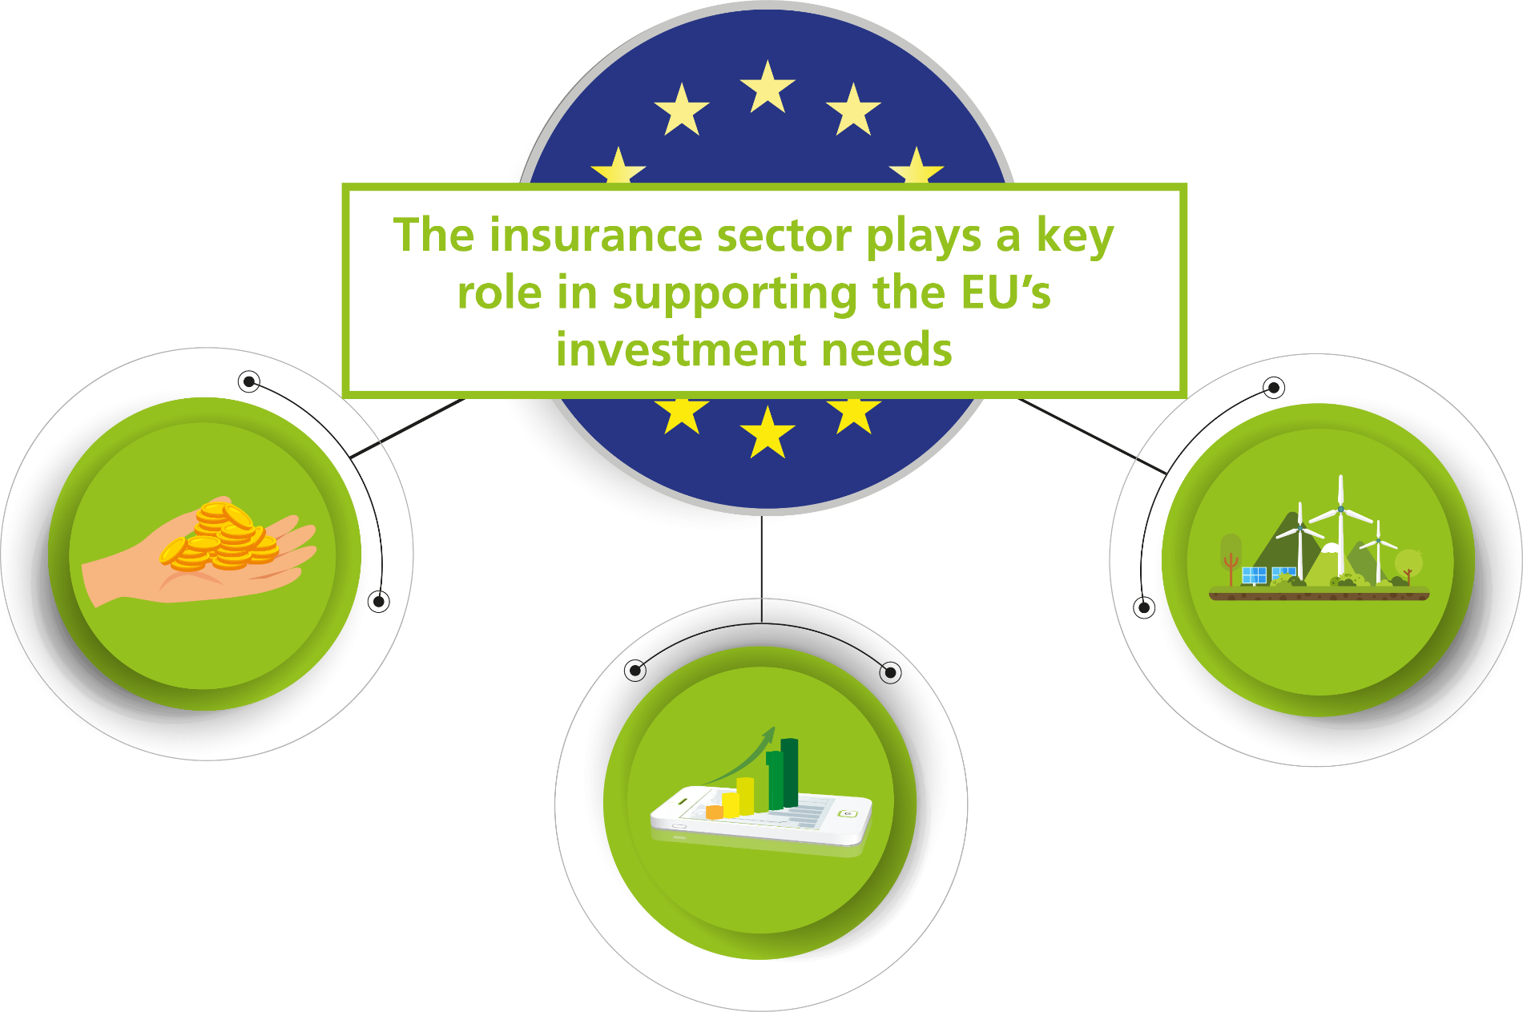
What are the consequences of exaggerated liabilities for the economy?

Slide 6
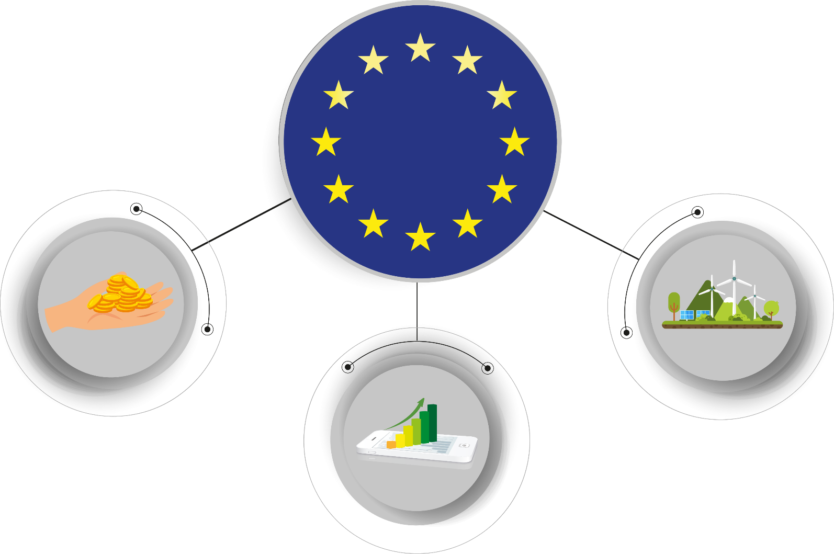
What are the consequences of exaggerated liabilities for the economy?
Insurers’ capacity to take risk and invest is influenced by how liabilities are valued
Appropriate valuation of liabilities is needed to allow insurers to support EU’s recovery, growth and sustainability objectives

Slide 7
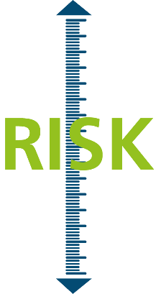






Solvency II review is opportunity to address flaws in valuation of liabilities
RISK MARGIN
RISK-FREE
INTEREST RATE
Enhance insurers’ ability to serve customers better according to their needs
Enhance insurers’ capacity to invest in line with EU objectives in Green Deal and Capital Markets Union

Slide 8
Why should the risk margin be significantly lower?
RISK MARGIN

Slide 9






Valuation of liabilities in Solvency II is extremely comprehensive
Unlike banks, insurers must forecast the best estimate of all their claims and expenses projected until all claims are paid.
This includes:
Claims administration
General administration
Personnel
costs
Claims
IT
Taxes
Projection period can be up to 60 years or even more

Slide 10







Valuation of liabilities in Solvency II is extremely comprehensive
Assets needed to support risk margin, SCR and
reserves based on Solvency II methodology
^{Reserves}
based on Solvency II methodology*
^{(“Technical provisions”)}
Amount needed to pay policyholder claims and other liabilities
* Not to scale

Slide 11

However, the valuation of liabilities also contains the risk margin
Solvency II requires insurers to hold significant extra assets not needed to pay expected claims
Risk margin is extra “hidden” layer
Not needed to pay claims and other liabilities
^{Risk margin}
Solvency II liabilities
=
reserves + risk margin
^{Reserves}
based on Solvency II methodology*
Needed to pay expected claims and expenses
* Not to scale

Slide 12


What is the risk margin?
Solvency Capital Requirement (SCR)
Minimum capital requirement (MCR)
^{Risk margin}
^{Reserves}
based on Solvency II methodology
Funds needed to “transfer” portfolio to a third party in extremely rare event of failure
Overly theoretical
On top of real reserves and capital

Slide 13
What is the risk margin?
Solvency II requires insurers to hold capital against all the risks to which they are exposed
Minimum capital requirement (MCR)
^{Risk margin}
Not needed to pay expected claims and expenses
^{Reserves}
based on Solvency II methodology*
Needed to pay expected claims and expenses
* Not to scale

Slide 14
What is the risk margin?
Solvency II requires insurers to hold capital against all the risks to which they are exposed
Available to cover unexpected claims
and expenses
Solvency Capital Requirement (SCR)
^{(€690bn)}
^{MCR (€250bn)}
^{Risk margin}
Not needed to pay expected claims and expenses
^{Reserves}
based on Solvency II methodology*
Needed to pay expected claims and expenses
* Not to scale
Figures Q1 2020, source: EIOPA

Slide 15
Insurers also hold additional buffer to reflect their own risk appetite
Insurance industry holds assets significantly in excess of regulatory requirement
Current
additional
buffers
(€880bn)
^{SCR}
^{(€690bn)}
^{Risk margin}
^{Assets}
^{Reserves}
based on Solvency II methodology*
* Not to scale
Figures Q1 2020, source: EIOPA

Slide 16
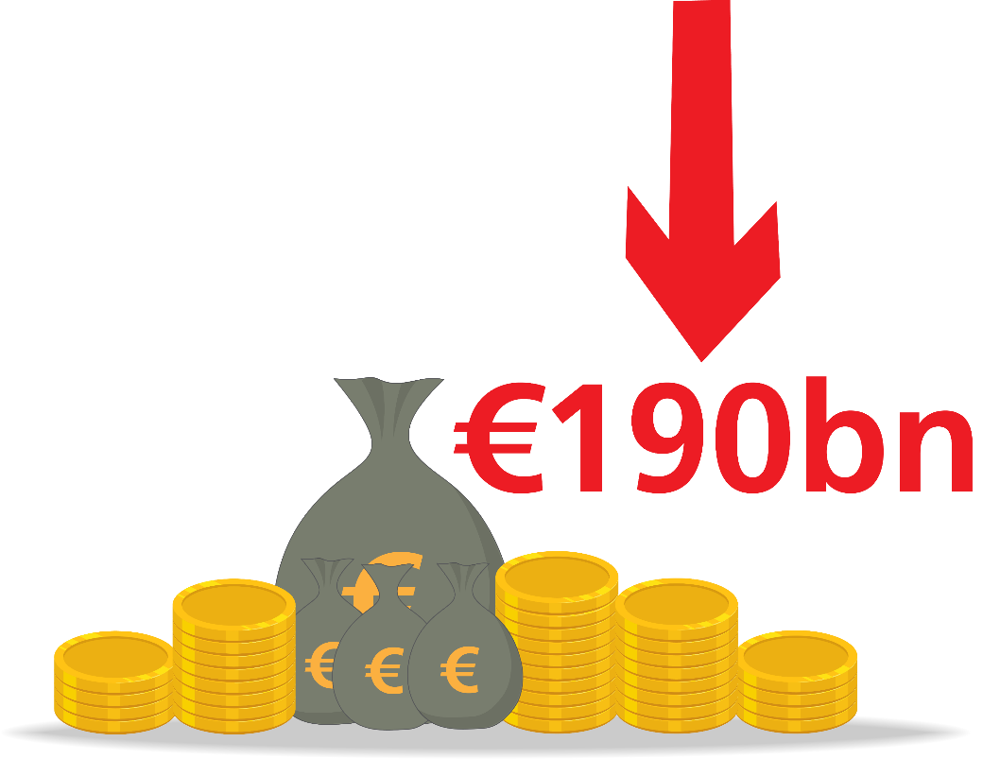

Current risk margin is far too high
It reduces risk-taking capacity of industry by up to €190bn
It can be another source of volatility
Risk margin should be significantly reduced and redesigned

Slide 17



Risk margin extremely punitive for long-term products
Non-life insurance
products
Life insurance
products
Long-term investment
products
100%
27%
40%
Risk margin is 27% of SCR on average
Risk margin is 40% of SCR on average
Risk margin can be in excess of 100% of SCR

Slide 18
Recognition that risk margin needs to be addressed
European Parliament’s ECON Committee:
“...we would like to draw your attention to the risk margin which in aggregate is very high and can have a significant impact on product pricing, design and availability as well as investment decisions, especially for those insurers with long-term business.” (18/9/2018)
European Commission call for advice to EIOPA:
“EIOPA is asked to assess the appropriateness of the design of the risk margin...” (11/2/2019)
EC Action Plan on CMU:
The review of Solvency II will notably assess the appropriateness of the eligibility criteria for the long-term equity asset class, the risk margin calculation, and the valuation of insurers’ liabilities (24/9/2020)

Slide 19
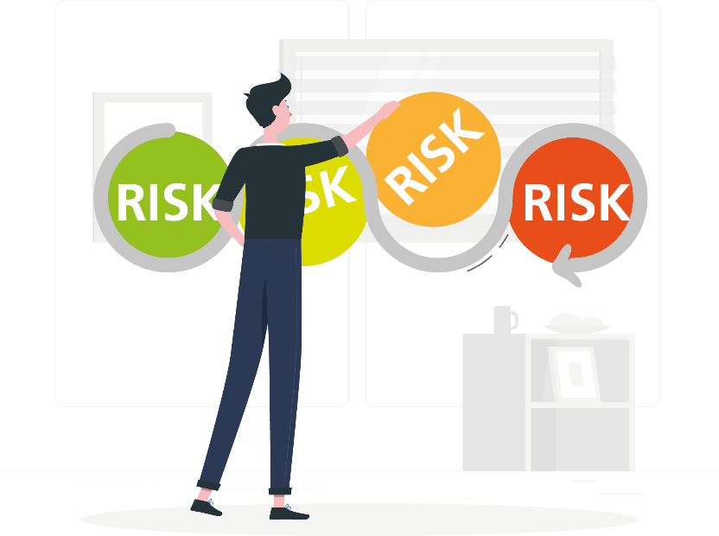


Strong justifications for lowering risk margin
Three key economic and technical reasons
Cost of capital
Diversification
Risk changes over time
Theoretical parameter needed to calculate risk margin, currently equal to 6%, but strong evidence that it should be set at 3%.
Many insurers have different types of business and their risks cannot all happen at the same time. Diversification should be fully taken into account.
For example, a policyholder terminating a contract cannot terminate the same contract again. This should not be ignored.

Slide 20

Strong justifications for lowering risk margin
But EIOPA is only looking at 1 out of 3
Cost of capital
Diversification
Risk changes over time

Slide 21




What could be the benefits of a lower risk margin?
Every €1 of lower risk margin could generate…
€1.70 in equity investments
€3 if the capital charge for long-term equity is properly corrected
€6 investment in green bonds
€9 if the dynamic volatility adjustment is extended to the standard formula in combination with existing spread risk charges
€1000 in windstorm protection
Based on a simplified model of an insurance company and standard formula — details are available on www.insuranceeurope.eu

Slide 22

Why is EIOPA’s proposed change to the methodology unnecessary?
RISK-FREE INTEREST RATE

Slide 23

What are risk-free interest rates?
They are needed to calculate today’s value of future claims and costs
Some information needed for the calculation, mostly long-term data, needs to be projected theoretically. Solvency II sets out a methodology to do this.

Slide 24



How are risk-free interest rates set?
Illustrative risk-free rate curve (€)
Based directly on market data
Market data is fully available and reliable under all conditions
“Liquid” risk-free rates
Defined up to last liquid point (LLP)
Based on projection methodology
Market data not available or not reliable enough under all conditions
Helps stabilise long-term liability values
Last Liquid Point
(LLP)

Slide 25

What has EIOPA proposed?
Illustrative risk-free rate curve (€)
EIOPA has proposed changing the projecting methodology
Last Liquid Point
(LLP)
EIOPA has considered increasing the LLP to 30 years
EIOPA proposals negatively impact Euro and non-Euro risk-free interest rates

Slide 26


Concerns with EIOPA’s proposals
Current methodology
EIOPA proposals
Meets all criteria defined in Solvency II
Uses appropriate market data
Reflects standard asset-liability management practices
Fully incorporates current very low/negative rates
Increases the costs of long-term liabilities
Increases industry dependence on derivatives
Increases volatility for many insurers
EIOPA proposals would increase value of liabilities, can increase volatility and would make it even harder for insurers to maintain long-term business

Slide 27

Current methodology already incorporates low interest rates
Current methodology is appropriate
Risk-free rate curve 2015/2020
Q3 2015
Q3 2020

Slide 28
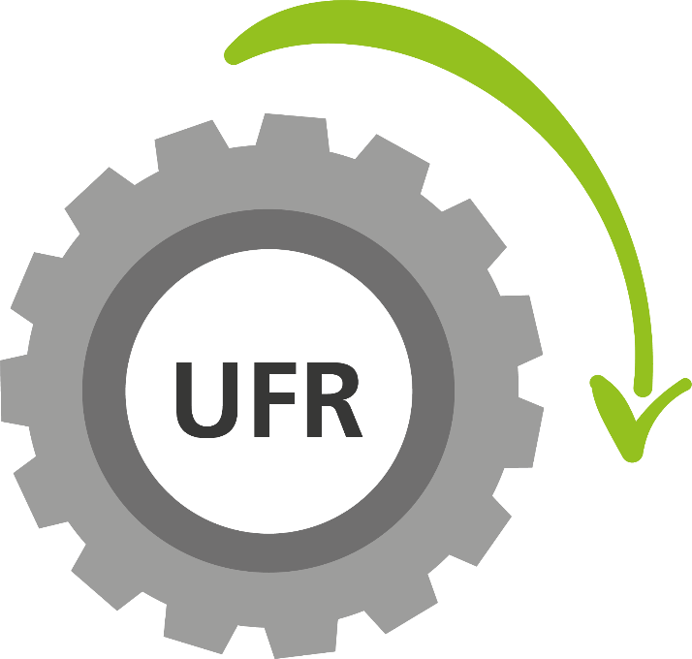
Current methodology already incorporates low interest rates
Changes to ultimate forward rate (UFR) over coming years will already lower
risk-free rates further
Risk-free rate curve 2020/2025*
Q3 2020
Q3 2025
* Note: 2025 risk-free rate curve assumes 2020 swap rates and 3.30% UFR

Slide 29
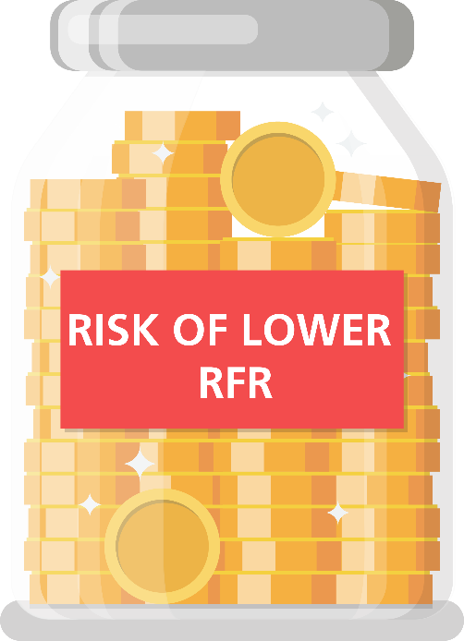
Capital requirements provide further protection
Interest rate SCR* ensures capital to cover even eventuality that risk-free rates
fall further
Risk-free rate curve
Q3 2020
Interest rate SCR
down curve
* Note: Interest rate down curve projected using Insurance Europe proposal

Slide 30



No need for change based on Solvency II’s criteria
Last liquid point (LLP) is based on three clear, transparent and risk-based criteria
Deep, liquid & transparent (DLT)
Matching
Residual volume
EIOPA did not consider DLT assessment of bonds in its advice.
Industry analysis shows no change in DLT for bonds from 2014 levels when the current LLP for the Euro was set.
EIOPA analysis ignores the ECB bond purchase programme.
Industry analysis shows a reduction in the LLP is warranted based on this criteria.
EIOPA’s analysis confirms there is no need to alter the LLP for the Euro.
EIOPA proposal requires deletion or amended interpretation
of these key criteria

Slide 31
Impact of EIOPA proposal
Reserves needed for €1000 payment
in 30 years time
Today
EIOPA
proposal
Value of long-term liabilities
+10%
€814
€890

Slide 32

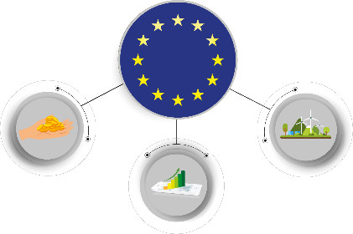

Impact of EIOPA proposal
Reserves needed for €1000 payment
in 30 years time
Today
EIOPA
proposal
Value of long-term liabilities
+10%
Increases the price of long-term products
Reduces insurers’ capacity to finance long-term investments
Increases insurers’ costs for existing long-term policies
€814
€890

Slide 33

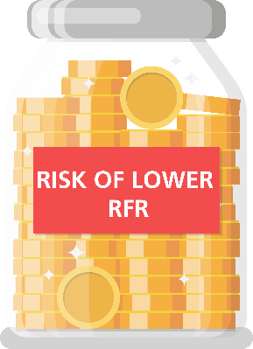





EIOPA’s proposal for risk-free rate methodology is unnecessary
Current methodology already reflects low interest rates
Planned changes to parameters will already lower risk-free rates further
Insurers already hold capital to cover the risk of lower risk-free rates
Criteria governing LLP should be maintained to correctly identify liquid risk-free rates
Proposal creates barriers to long-term investment
Proposal increases price of long-term products
Proposal increases industry dependence on derivatives

Slide 34
Solvency II review is opportunity to address flaws in valuation of liabilities
RISK MARGIN
RISK-FREE
INTEREST RATE
Enhance insurers’ ability to serve customers better according to their needs
Enhance insurers’ capacity to invest in line with EU objectives in Green Deal and Capital Markets Union

