Slide 1

Regulation of Insurance Intermediation in UK
James Bridge – Head of Conduct, Association of British Insurers
18 November 2015

Slide 2




UK Regulatory Regime
FCA Operational Objectives:
Securing an appropriate degree of protection for consumers
Protecting and enhancing the integrity of the UK financial system
Promoting effective competition in the interests of consumers
After April 2013
Before April 2013

Slide 3
Retail Distribution Review - Background
The Retail Distribution Review (RDR) was announced in 2006 for retail investment market
Concerns included:
  commission and conflicts of interest
  standards of professionalism
  quality of advice
The review and recommendations ran between 2007 and 2012
RDR did not consider non-life products offered by general insurance intermediaries

Slide 4
Retail Distribution Review - Scope
Products
life policies
units
stakeholder pension schemes
personal pension schemes
an interest in an investment trust savings scheme
a security in an investment trust
other investments with exposure to underlying financial assets
Providers
retail banks
life insurers
financial advisers
building societies
stockbrokers
fund managers
Notes:
‘Retail investment product’ is defined in the Handbook as:
(a) a life policy; or
(b) a unit; or
(c) a stakeholder pension scheme; or
(d) a personal pension scheme; or
(e) an interest in an investment trust savings scheme; or
(f) a security in an investment trust; or
(g) any other designated investment which offers exposure to underlying financial assets, in a
packaged form which modifies that exposure when compared with a direct holding in a financial
asset; or
(h) a structured capital-at-risk product;
whether or not any of a) to h) are held within an ISA or a child trust fund (CTF).

Slide 5


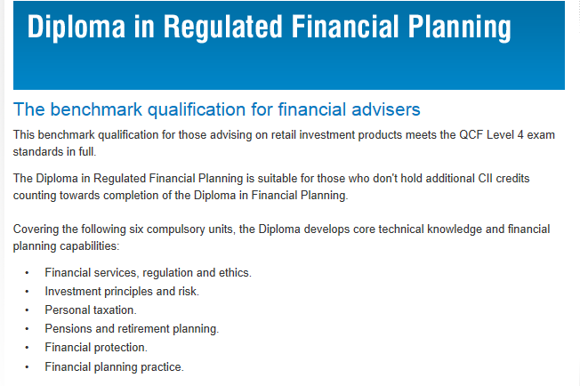
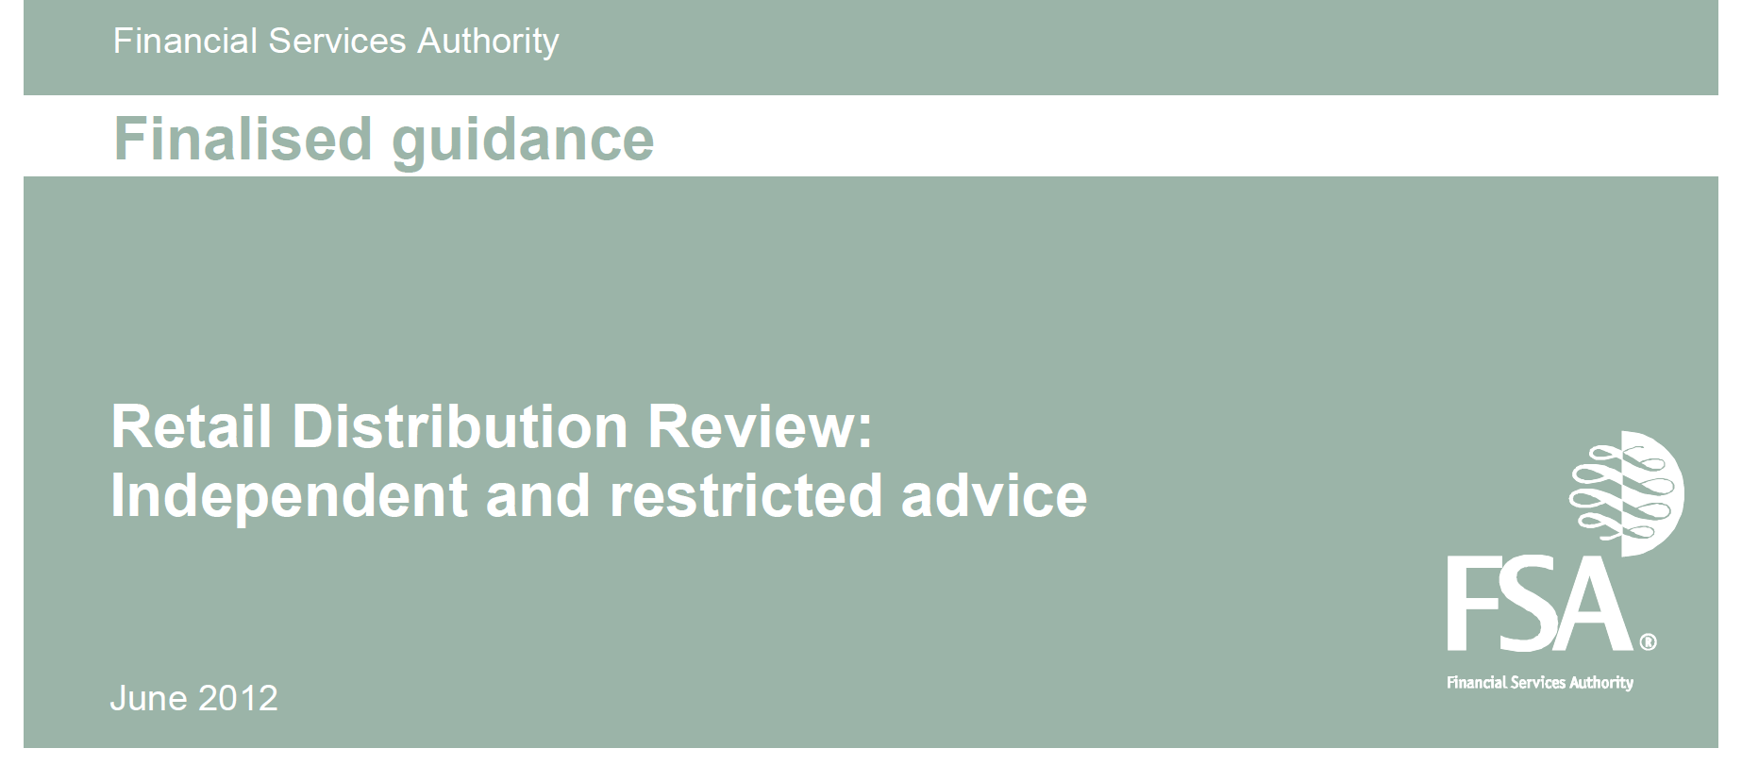
Retail Distribution Review - Changes
RDR was implemented on 31 December 2012. The Key changes:
Notes:
‘Retail investment product’ is defined in the Handbook as:
(a) a life policy; or
(b) a unit; or
(c) a stakeholder pension scheme; or
(d) a personal pension scheme; or
(e) an interest in an investment trust savings scheme; or
(f) a security in an investment trust; or
(g) any other designated investment which offers exposure to underlying financial assets, in a
packaged form which modifies that exposure when compared with a direct holding in a financial
asset; or
(h) a structured capital-at-risk product;
whether or not any of a) to h) are held within an ISA or a child trust fund (CTF).

Slide 6
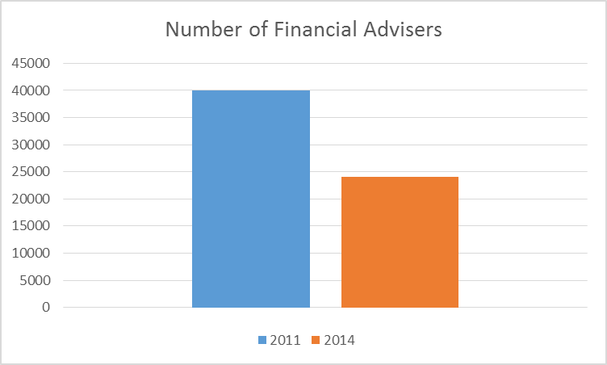
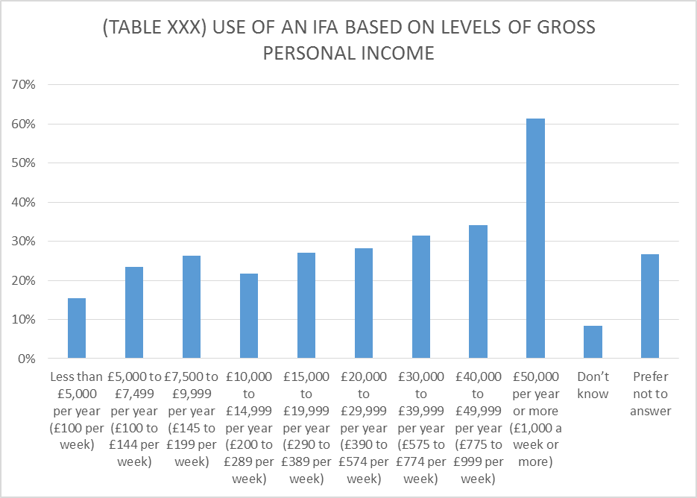
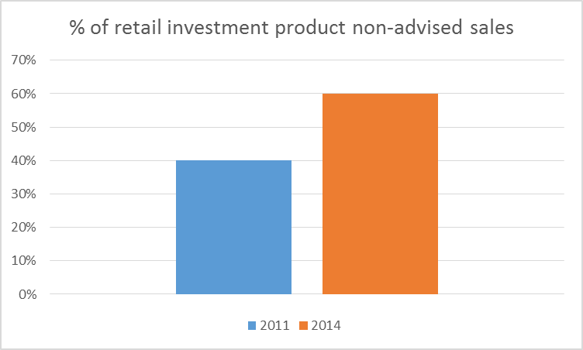
Impact of Retail Distribution Review
Notes:
‘Retail investment product’ is defined in the Handbook as:
(a) a life policy; or
(b) a unit; or
(c) a stakeholder pension scheme; or
(d) a personal pension scheme; or
(e) an interest in an investment trust savings scheme; or
(f) a security in an investment trust; or
(g) any other designated investment which offers exposure to underlying financial assets, in a
packaged form which modifies that exposure when compared with a direct holding in a financial
asset; or
(h) a structured capital-at-risk product;
whether or not any of a) to h) are held within an ISA or a child trust fund (CTF).

Slide 7
The ‘Advice Gap’
Average cost of financial advice is eur 2104
Financial advisors have reviewed their client base and stopped serving uneconomic clients
Customers with less to invest (most UK consumers in practise) either cannot afford, or do not want to pay, for advice
Advice has become a ‘luxury good’
Changes to UK pension market in 2015 ‘freedom and choice’
Greater reliance on information and generic advice
Development of ‘robo-advice’ solutions – from eur 285
Product sales are generally stable
Notes:
Origins:
Babylonian traders
Modern ins:
Lloyds coffee house
Shipping
Great Fire of London
Evolution – horse & cart becomes motor
Purpose & concept of insurance?
Indemnification
Insurance interest
Transfer of risk – supports individuals & businesses to take risks

Slide 8
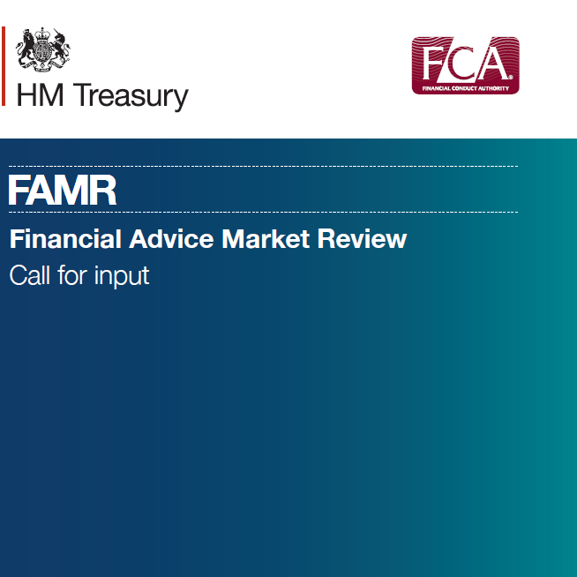
What’s next?
Call for Input
Closes on 22 December
Invites views on how the UK advice market can work for all consumers
Creation of a ‘Regulatory Sandbox’
Many responses expected!
Notes:
Origins:
Babylonian traders
Modern ins:
Lloyds coffee house
Shipping
Great Fire of London
Evolution – horse & cart becomes motor
Purpose & concept of insurance?
Indemnification
Insurance interest
Transfer of risk – supports individuals & businesses to take risks

Slide 9
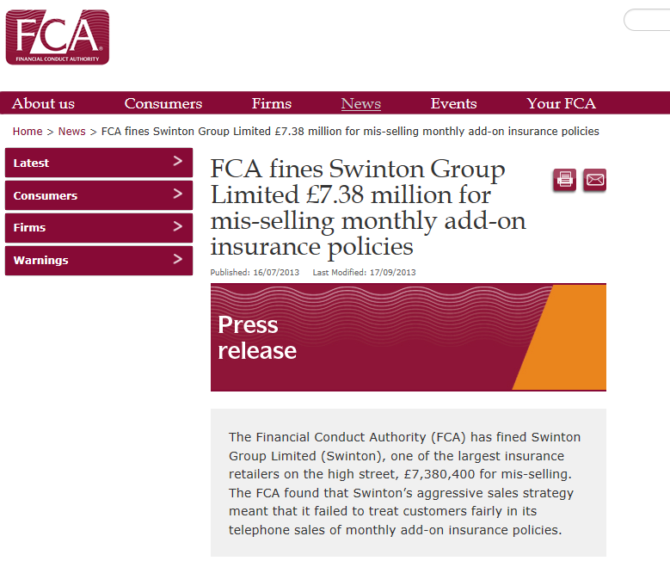
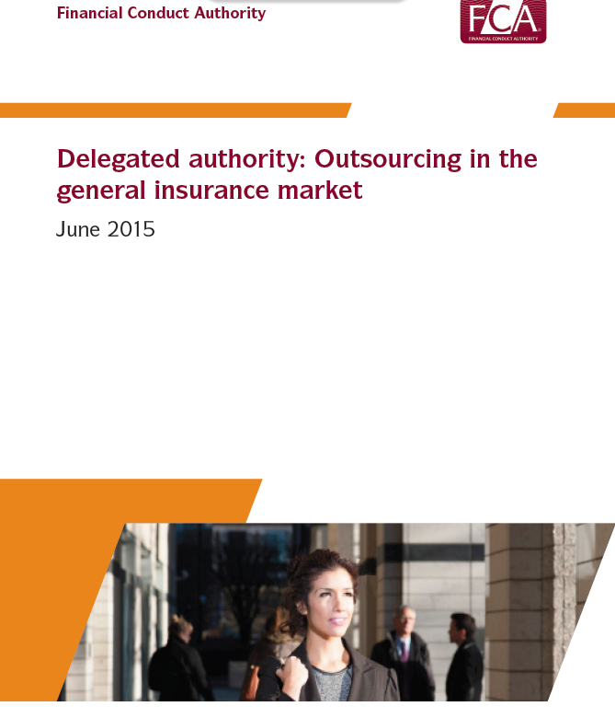
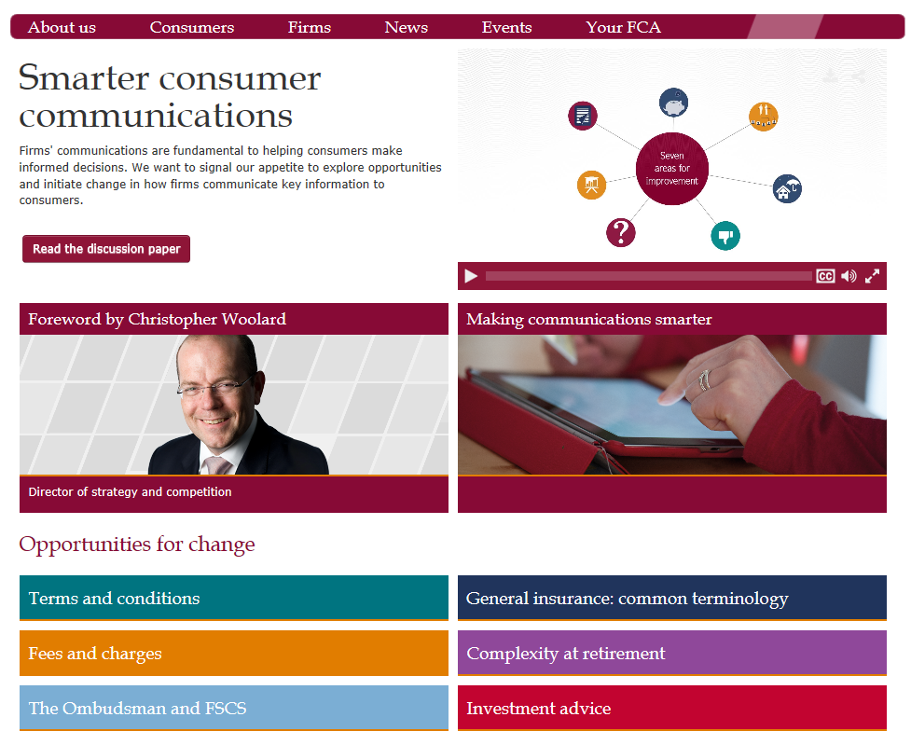
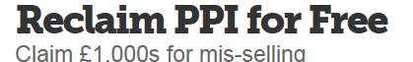
^{General Insurance}

Slide 10
Insurance Distribution Directive – UK questions
Disclosure of the ‘nature of remuneration’?
Professional requirements – how should this be monitored?
Cross-selling text is unclear
Insurance Product Information Document – how do we make this user friendly for customers?
Notes:
Origins:
Babylonian traders
Modern ins:
Lloyds coffee house
Shipping
Great Fire of London
Evolution – horse & cart becomes motor
Purpose & concept of insurance?
Indemnification
Insurance interest
Transfer of risk – supports individuals & businesses to take risks

Slide 11
Ďakujem
Notes:
Origins:
Babylonian traders
Modern ins:
Lloyds coffee house
Shipping
Great Fire of London
Evolution – horse & cart becomes motor
Purpose & concept of insurance?
Indemnification
Insurance interest
Transfer of risk – supports individuals & businesses to take risks

