Slide 1
Solvency II review:
EIOPA’s unnecessary risk correction and liquidity double buffer make the VA worse

Slide 2


The problem
EIOPA proposes two new elements to the volatility adjustment (VA)
RISK CORRECTION
LIQUIDITY ADJUSTMENT
FACTOR
THESE WILL MAKE THE VA MORE VOLATILE, LESS EFFECTIVE
AND MORE COMPLICATED THAN NECESSARY

Slide 3

Is EIOPA’s analysis the right starting point?
RISK CORRECTION

Slide 4



Concerns with EIOPA’s arguments and proposals
The EIOPA analysis is flawed:
EIOPA focuses on assets representing <1% of portfolio
The current risk correction is already conservative enough
The changes would:
make the VA worse at mitigating volatility
neutralise improvements from the “option 7” country component
RISK CORRECTION
… and reduce insurers’ capacity to take risk and invest:
This will undermine EU political objectives of encouraging recovery, growth and sustainable investment
THE RISK CORRECTION SHOULD NOT BE CHANGED

Slide 5
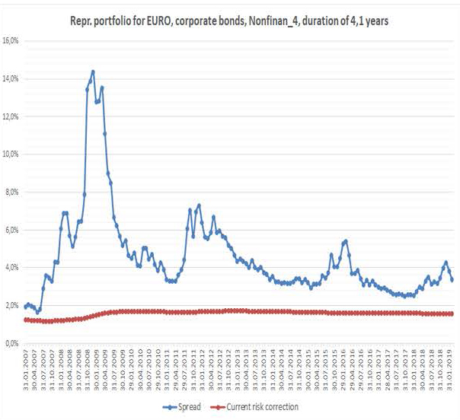
Flaws in EIOPA’s arguments and proposals
EIOPA says this shows an increase in defaults during the 2008 crisis
EIOPA-BoS-19/465 “Consultation paper on the opinion on the 2020 review of Solvency II” p93

Slide 6

Flaws in EIOPA’s arguments and proposals
EIOPA says this shows an increase in defaults during the 2008 crisis
Yet the risk correction
hardly increases
EIOPA-BoS-19/465 “Consultation paper on the opinion on the 2020 review of Solvency II” p93

Slide 7

Flaws in EIOPA’s arguments and proposals
EIOPA says this shows an increase in defaults during the 2008 crisis
BUT the huge movements shown in the graph
are of spreads and NOT defaults
EIOPA-BoS-19/465 “Consultation paper on the opinion on the 2020 review of Solvency II” p93

Slide 8
Flaws in EIOPA’s arguments and proposals
EIOPA’s graph also uses BB bonds as evidence
EIOPA-BoS-19/465 “Consultation paper on the opinion on the 2020 review of Solvency II” p93

Slide 9
Flaws in EIOPA’s arguments and proposals
EIOPA’s graph also uses BB bonds as evidence
BUT BB bonds represent
<1% of insurers’ assets
EIOPA-BoS-19/465 “Consultation paper on the opinion on the 2020 review of Solvency II” p93

Slide 10
Flaws in EIOPA’s arguments and proposals
Looking at the actual losses from defaults
EIOPA-BoS-19/465 “Consultation paper on the opinion on the 2020 review of Solvency II” p93

Slide 11
Flaws in EIOPA’s arguments and proposals
Looking at the actual losses from defaults
EIOPA-BoS-19/465 “Consultation paper on the opinion on the 2020 review of Solvency II” p93
There are slight increases for these bonds after crises …

Slide 12
Flaws in EIOPA’s arguments and proposals
Looking at the actual losses from defaults
EIOPA-BoS-19/465 “Consultation paper on the opinion on the 2020 review of Solvency II” p93
… BUT below current risk correction,
which is conservative enough

Slide 13
Flaws in EIOPA’s arguments and proposals
This is confirmed by looking at loss data going back to 1981 AND …
… is even more true for the bonds actually held by insurers eg BBB or A
* Risk correction assumes equal split between financial and non-financial bonds

Slide 14
There is recognition that the VA must be improved
European Parliament’s ECON Committee:
“...fix the critical issues related to the VA and other LTG measures, which will need to be properly assessed and addressed during the 2020 Review.” (18/9/2018)
European Commission call for advice to EIOPA:
“EIOPA is asked to assess the efficient functioning of the volatility adjustment and the matching adjustment as mechanisms to prevent pro-cyclical behaviour on financial markets...” (11/2/2019)
High-Level Forum on the CMU:
“Ensuring that insurers’ own funds are appropriately valued and are not too volatile, in particular looking at what improvements can be made to the Volatility Adjustment to avoid exaggerating either way the valuation of projected long-term liabilities and reduce artificial volatility.” (10/6/2020)

Slide 15
EIOPA’s proposals make VA even worse at mitigating volatility
Solvency
Ratio*
Artificial volatility problem the Solvency II review aims to address
Current VA is not good enough at mitigating volatility
* Simplified example of an insurance company with 10-year liabilities, fully matched with 10-year maturity fixed-income assets invested in exactly the reference portfolio. As our focus is on balance sheet volatility, for simplicity the SCR is assumed to stay constant over time.

Slide 16
EIOPA’s proposals make VA even worse at mitigating volatility
Solvency
Ratio*
Artificial volatility problem the Solvency II review aims to address
EIOPA proposals makes VA worse, not better
Increasing, not decreasing, artificial volatility and making Solvency II more procyclical

Slide 17

And would neutralise improvements to country component (“option 7”)
Example: Portuguese volatility adjustment
* Duration ratio assumed to be 100%

Slide 18
And would neutralise improvements to country component (“option 7”)
Example: Portuguese volatility adjustment
EIOPA “option 7” proposal
+
EIOPA proposals to rescale fixed-income assets and improve general application ratio (GAR)
=
improved country component
* Duration ratio assumed to be 100%

Slide 19
And would neutralise improvements to country component (“option 7”)
Example: Portuguese volatility adjustment
EIOPA’s improvements (“option 7”, etc)
+
EIOPA risk correction & liquidity ratio proposals
=
almost no improvement in country component
* Duration ratio assumed to be 100%

Slide 20
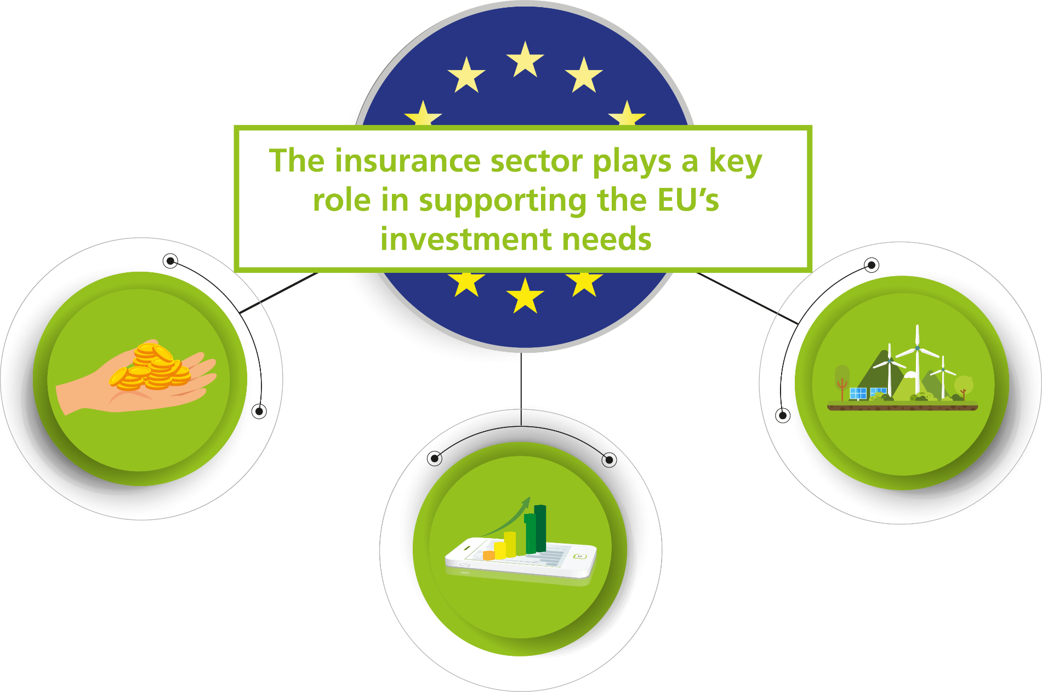
A VA that works well is a key element to improve Solvency II

Slide 21
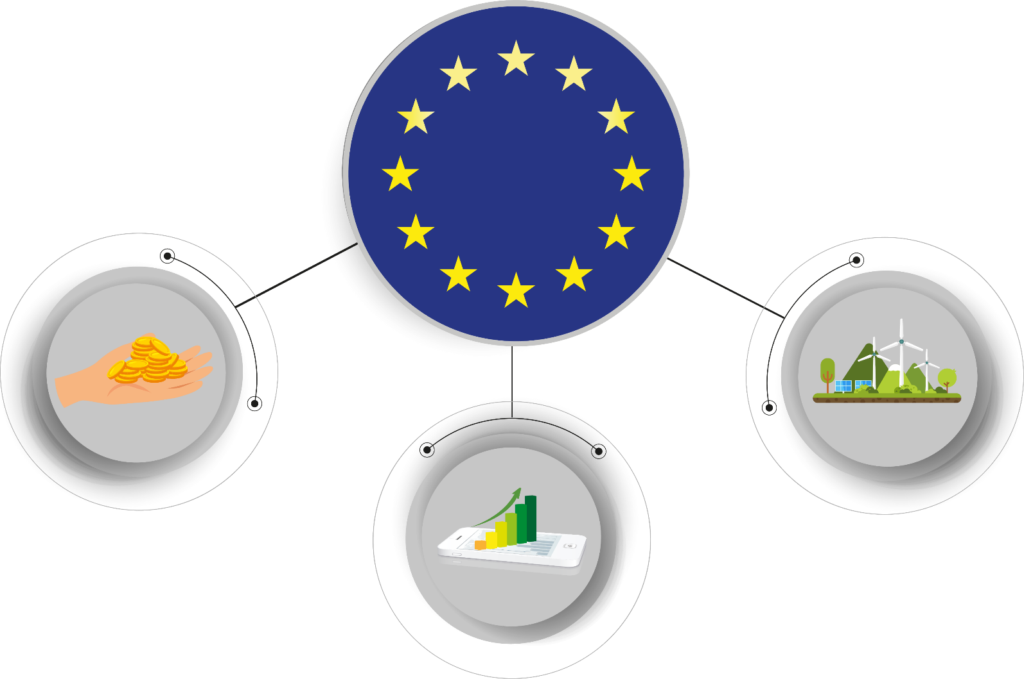
A VA that works well is a key element to improve Solvency II
The changes to the risk correction would reduce insurers’ ability to take risk and invest
A VA that functions well is needed to allow insurers to support EU’s recovery, growth & sustainability objectives

Slide 22
Concerns with EIOPA’s arguments and proposals
The EIOPA analysis is flawed:
EIOPA focuses on assets representing <1% of portfolio
The current risk correction is already conservative enough
The changes would:
make the VA worse at mitigating volatility
neutralise improvements from the “option 7” country component
RISK CORRECTION
… and reduce insurers’ capacity to take risk and invest:
This will undermine EU political objectives of encouraging recovery, growth and sustainable investment
THE RISK CORRECTION SHOULD NOT BE CHANGED

Slide 23

Is EIOPA’s analysis the right starting point?
LIQUIDITY ADJUSTMENT
FACTOR

Slide 24
Concerns with EIOPA’s arguments and proposals
Liquidity should be dealt with under Pillar 2 & 3
Correct liquidity measurement requires a comprehensive assessment
Introducing a liquidity adjustment factor in the calculation of liabilities would lead to double counting
LIQUIDITY ADJUSTMENT
FACTOR
THERE SHOULD BE NO LIQUIDITY ADJUSTMENT FACTOR ADDED TO THE VA CALCULATION

Slide 25
Liquidity should be dealt with under Pillar 2 and 3
SOLVENCY II
Pillar 1
Capital requirements
Pillar 2
Risk management
Pillar 3
Disclosure

Slide 26

Correct liquidity measurement requires a comprehensive assessment
EIOPA basis for liquidity adjustment factor
Causes of liquidity in liabilities, eg:
Lapse shock, etc

Slide 27

Correct liquidity measurement requires a comprehensive assessment
Correct, meaningful liquidity assessment
Causes of liquidity in liabilities, eg:
Lapse shock, etc
+
Mitigants, eg:
Supervisory powers to intervene to prevent lapse shocks
Customer penalties (imposed by insurer or tax authorities)
+
Sources of liquidity, eg:
New premium flow
Maturing investments and income from investments (dividends, rental income and interest payments)
Liquid assets including cash, shares, bonds
Reinsurance
Committed credit lines
Intra-group liquidity

Slide 28

Proposals for liquidity adjustment will lead to double counting
THE CAPITAL CALCULATIONS (SCR) ALREADY INCLUDE SCENARIOS WHERE LIABILITIES CAN BE BROUGHT FORWARD & ARE NOT DISCOUNTED

Slide 29


Proposals for liquidity adjustment will lead to double counting
A LIQUIDITY ADJUSTMENT FACTOR WOULD LEAD TO DOUBLE COUNTING

Slide 30
Concerns with EIOPA’s arguments and proposals
Liquidity should be dealt with under Pillar 2 & 3
Correct liquidity measurement requires a comprehensive assessment
Introducing a liquidity adjustment factor in the calculation of liabilities would lead to double counting
LIQUIDITY ADJUSTMENT
FACTOR
THERE SHOULD BE NO LIQUIDITY ADJUSTMENT
FACTOR ADDED TO THE VA CALCULATION

