Slide 1
Integrating climate change related risk into EU prudential regulation
June 2021

Slide 2







Insurers recognise and share concern about climate change risk
Insurers support the European Green Deal:
Objectives
Targets
Policy initiatives
Recognise the important role insurers can and should play:
Investment
Adaptation
Protection

Slide 3

EC policy initiatives are increasing the already strong pressure
Management:
“How can the company contribute?”
Consumer:
“Where can I find a green insurance product?”
Employee:
“Is my company having a negative impact on society?”
Regulator:
“Insurers should manage and mitigate sustainability risks and adopt a sustainable approach to their investments”
Shareholder: “ESG issues have become much more important for us”
Employee expectations
Regulatory initiatives
NGO:
“Insurance companies must divest from fossil fuel companies and invest in renewable energies”
Customer expectations
Shareholders
NGO pressure
Future generations
Future generations:
“77% of millennials have cited socially responsible and impactful investing as their top priority in a global survey”
Insurer
Notes:
Growing pressure on the industry: Beyond regulatory pressure, there are other sources of pressure from NGOs, consumers, employees, shareholders, etc.
Sustainability and climate change related EU policy objectives are not new – what is new is the increasing ambition, scope and sense of urgency, as well as increased direct impact on the financial sector, which translated into a number of new initiatives of relevance for the industry especially at EU level (from few targeted initiatives to a large set of initiatives putting the industry under pressure)

Slide 4
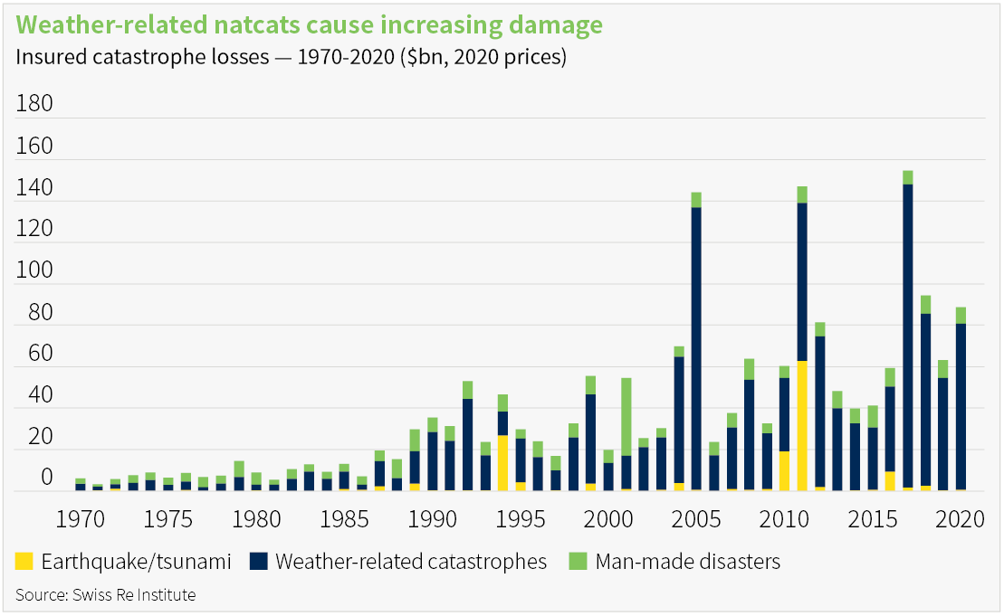
Climate risks for insurers : Physical risks
Extreme weather events are increasing, but annual pricing allows insurers to adjust to the risk
Majority of affected insurance is annual, so insurers can monitor changes to the climate risk landscape and make adjustments to pricing and/or product offerings
While the physical risks are manageable for insurers, significant climate change could limit insurability of certain risks over the longer-term (2030–2050)

Slide 5

Climate risks for insurers : Transition (stranded asset) risk
EIOPA’s December 2020 report* found insurers’ exposure relatively limited and risks “manageable”
“The overall impact on the balance sheets of the insurance sector is counter-balanced both by investments in renewable energy and the fact that the high-carbon investments considered here account for a small part of the total investments of European insurers.”
EIOPA conclusions* :
* EIOPA report “Sensitivity analysis of climate-change related transition risks” (December 2020) assessed climate-change related transition risks for EEA insurers. Using SII reporting which provides supervisors and EIOPA with asset-by-asset data for each insurer

Slide 6

Insurers’ actions to limit and reduce exposures are accelerating
European insurers are leading the way on …
Sustainable investments
Integrating sustainable investment strategies/approaches: exclusions, ESG screening, impact investing, stewardship and engagement
Specific policies and timescales for divestment from fossil fuel (especially new and coal)
Sustainable underwriting
Policies on sustainability impact of underwriting policies, with specific timescales to stop underwriting fossil fuel projects (especially new and coal)
Sustainable products
Increasing offer of products with a sustainability component, eg both insurance products with a risk protection (protection-based products) or investment-based products
Voluntary disclosures and initiatives
Task Force on Climate-Related Disclosures (TCFD), the 2018 Carbon Disclosure Report (CDP), ClimateWise, UN Environment Programme - Finance Initiative (UNEP FI), Net-Zero Underwriting Alliance, Net-Zero Asset Owner Alliance

Slide 7
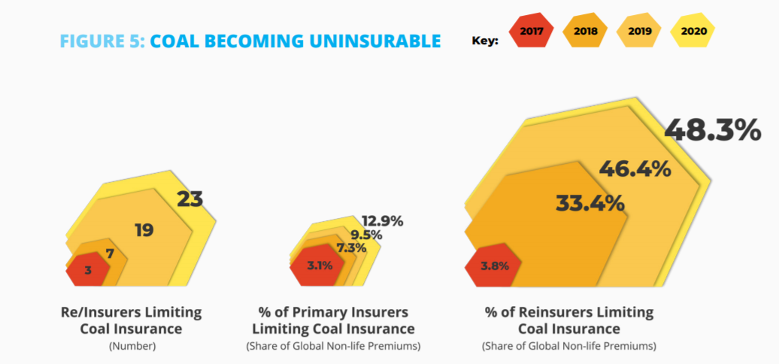
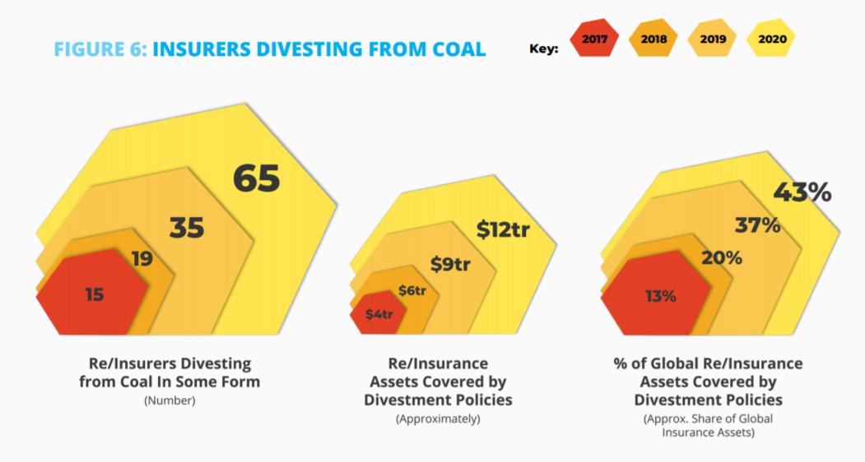
Insurers’ actions to limit and reduce exposures are accelerating
Source: Insure our Future 2020 report
Notes:
/wp-content/uploads/2020/12/UNINSURABLE-FINAL_M.png here

Slide 8
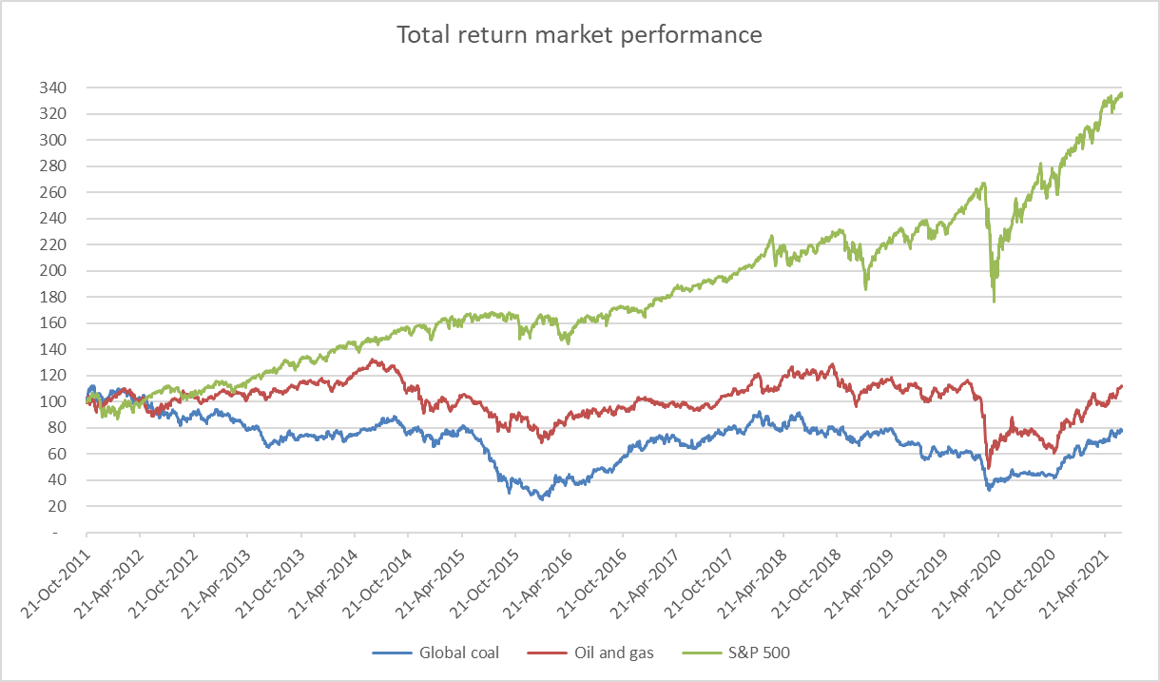
And the market appears to be reacting to transition risk
Over the last 10 years Oil & Gas has underperformed market by 300%, Coal by over 400%
Oil & Gas and Coal sectors show very significant underperformance relative to the market
Source: Refinitiv

Slide 9
SII already covers all risks but focus on sustainability is being significantly increased
Changes are under way to widen, accelerate and monitor insurers’ shift away from climate risks
SOLVENCY II
Other key initiatives
Specific mention of sustainability risks (SR) in risk management, underwriting reserving, ORSA, actuarial function and remuneration
Prudent person principle: not only SR, but also long-term impacts on sustainability factors
NATCAT risk module of the SCR (re)calibration
Underwriting: impact underwriting, pricing of risks, etc.
Scenario analysis in ORSA
Stress Testing and EIOPA’s ongoing monitoring of transition risk
1
Sustainable Finance Disclosure Regulation (SFDR)
Taxonomy Regulation
Corporate Sustainability Reporting Directive (CSRD)
European Single Access Point (ESAP)
EU Green Bond Standard
Sustainable Corporate Governance
…
2
3
4
5
6

Slide 10
The insurance industry does not support green/brown factors
“Green” doesn’t automatically mean low risk or “brown” high risk
Solvency II should stay a risk and evidence based framework
Market prices should already reflect all relevant risks — should be careful about seconding guessing the markets — however the market needs information…
…so, EC disclosure initiatives that will provide transparent, consistent information are key to ensure market prices adjust appropriately (and exposures can be monitored and good sustainable investment decisions made)
Any differential treatment between green assets or brown assets should be based on the difference in underlying risks
Unintended consequences must be considered (bubbles, cliff-edge effects)

Slide 11



Insurer’s role in sustainable transformation depends on EU initiatives
Disclosure initiatives
(SFDR, taxonomy,
CSRD, ESAP)
European Green Deal
CMU
Solvency II review
Desired outcomes:
Desired outcome:
Desired outcomes:
Availability of ESG data to drive investment changes
Accelerate change across all businesses and citizens
Capital requirements reflect long-term nature of insurers’ liabilities and investments
Transparency on ESG risks and behaviour using the right KPIs (for insurers) to monitor exposure and activities and drive sustainable change
Availability of enough attractive sustainable investments
Insurers provide long-term/guaranteed products
Insurers invest in long-term sustainable assets
Notes:
An insurer’s investment capacity and ability to allocate capital to investments is dependent on:
the nature of the liabilities – insurers generally have very stable balance sheets and aim to match their assets and liabilities
the availability of appropriate investments and their risk/return characteristics
the regulatory capital treatment – too little capital can jeopardise policyholder protection but too much capital increases costs, restricts product design and availability

Slide 12
Insurers recognise and share concern about climate change risk
The way forward
Current assessments indicate that climate change risks are manageable for insurers (but not for society). Insurers are taking action to reduce the risks further – but monitoring is key
Insurers have a clear role to play in the wider objective for sustainable transformation of the economy. Their activities in this respect are significant and increasing, but they recognise that even more needs to be done.
The EC’s current and planned regulatory and policy initiatives are supported by the industry. These will accelerate and broaden the changes made by insurers but also (crucially) the changes needed from citizens and businesses across the entire economy
Green and brown factors that are not risk-based are not supported by the industry
Insurers ability to play their full role in Europe’s climate and sustainability challenge depends on key regulatory initiatives being finalised and implemented in the right way

Slide 13
For more information
www.insuranceeurope.eu/priorities/5/solvency-ii
ecofin@insuranceeurope.eu

